Slide 1
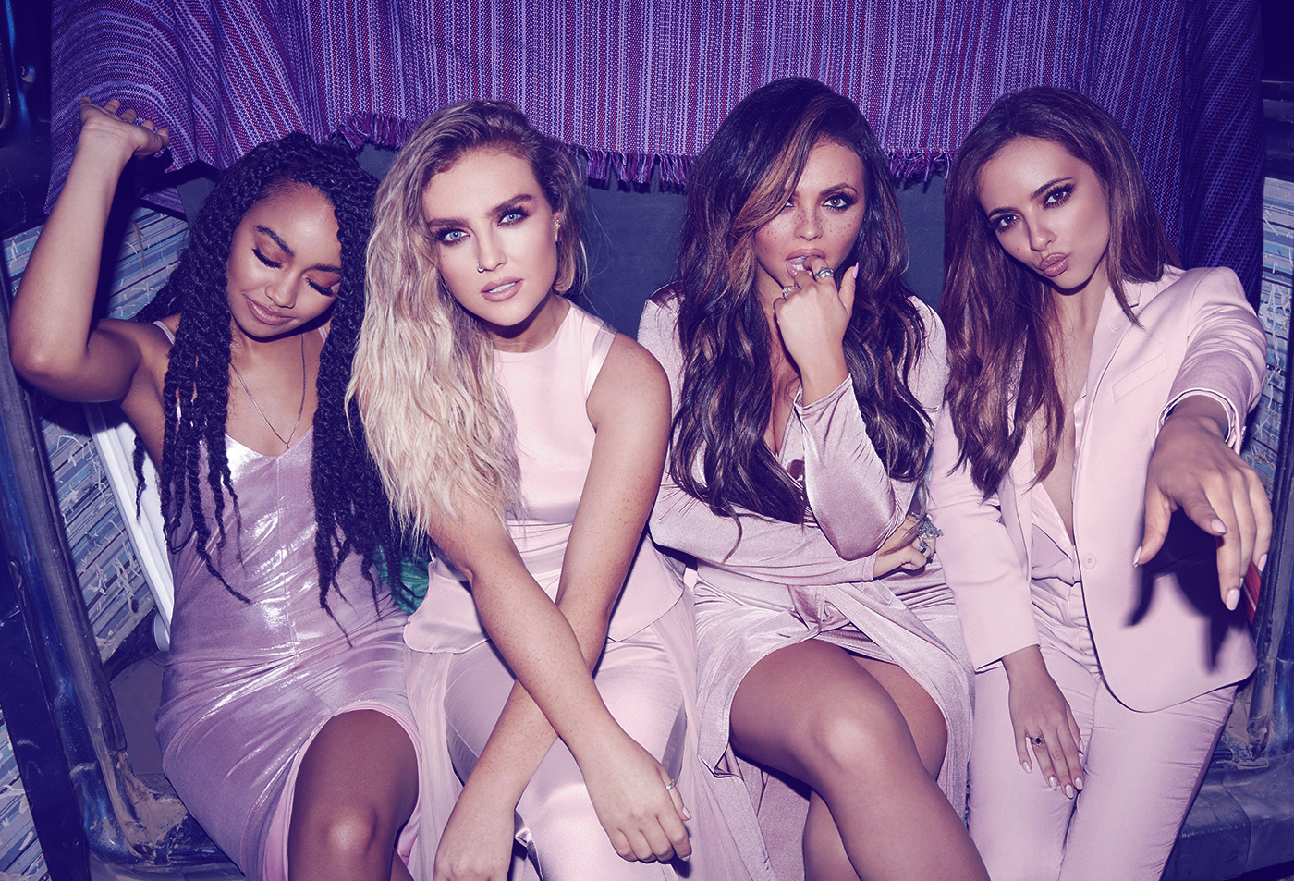
4Music & Box Channels
Q3 2018

Slide 2
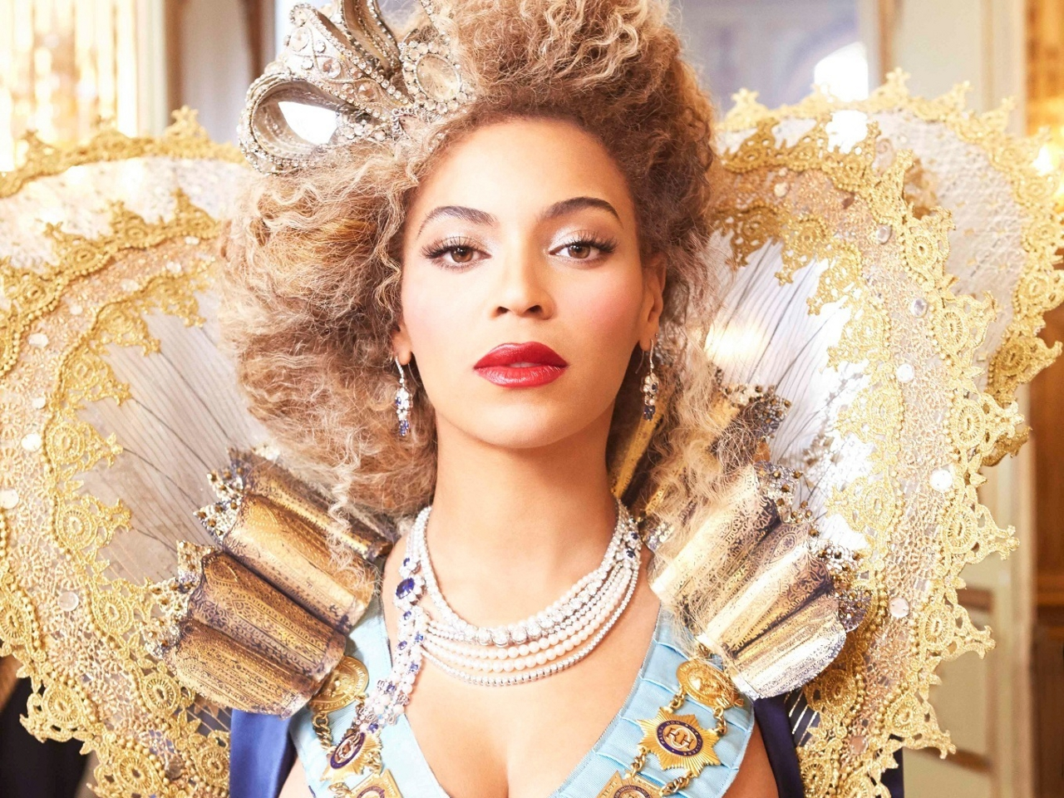
Channel Profile
Source: BARB/Advantedge, Q3 2018

Slide 3
Q3 highlights
4Music viewers are commercially receptive, celebrities influence their purchase decisions (i=213) and they tend to buy products from companies who sponsor TV shows (i=241)
4Music & the Box channels reach 23% of 16-34s every month (3.3m)
31% of 4Music viewers, and 52% of BOX MUSIC viewers are aged 16-34
They are trendsetters – they buy new products before most of their friends (i=187) and people come to them for advice before buying new things (i=158).
Source:. 1. BARB/Advantedge, Q3 2018, 2. TGI, 07/17-06/18, base = adults 16+.

Slide 4
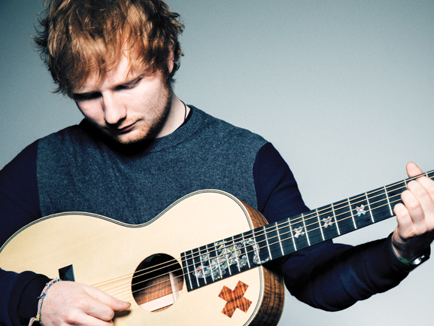
Top rating 4Music programmes
16-34s
 | Programme Title | TVR
1 | 8 OUT OF 10 CATS | 0.47
2 | 8 OUT OF 10 CATS: UNCUT | 0.43
3 | RUDE TUBE: SUPER PRANKS | 0.43
4 | SEX AND THE CITY | 0.35
5 | SUN, SEX & SUSPICIOUS PARENTS | 0.32
6 | VOTW: DAVID GUETTA | 0.31
7 | CHARMED | 0.30
8 | RUDE TUBE: WEB CELEBS | 0.29
9 | BIG HITS HOT VIDS | 0.26
10 | THE FESTIVAL: MOVIE SPECIAL | 0.25
Source: BARB/Advantedge, Q3 2018, unique programme titles

Slide 5
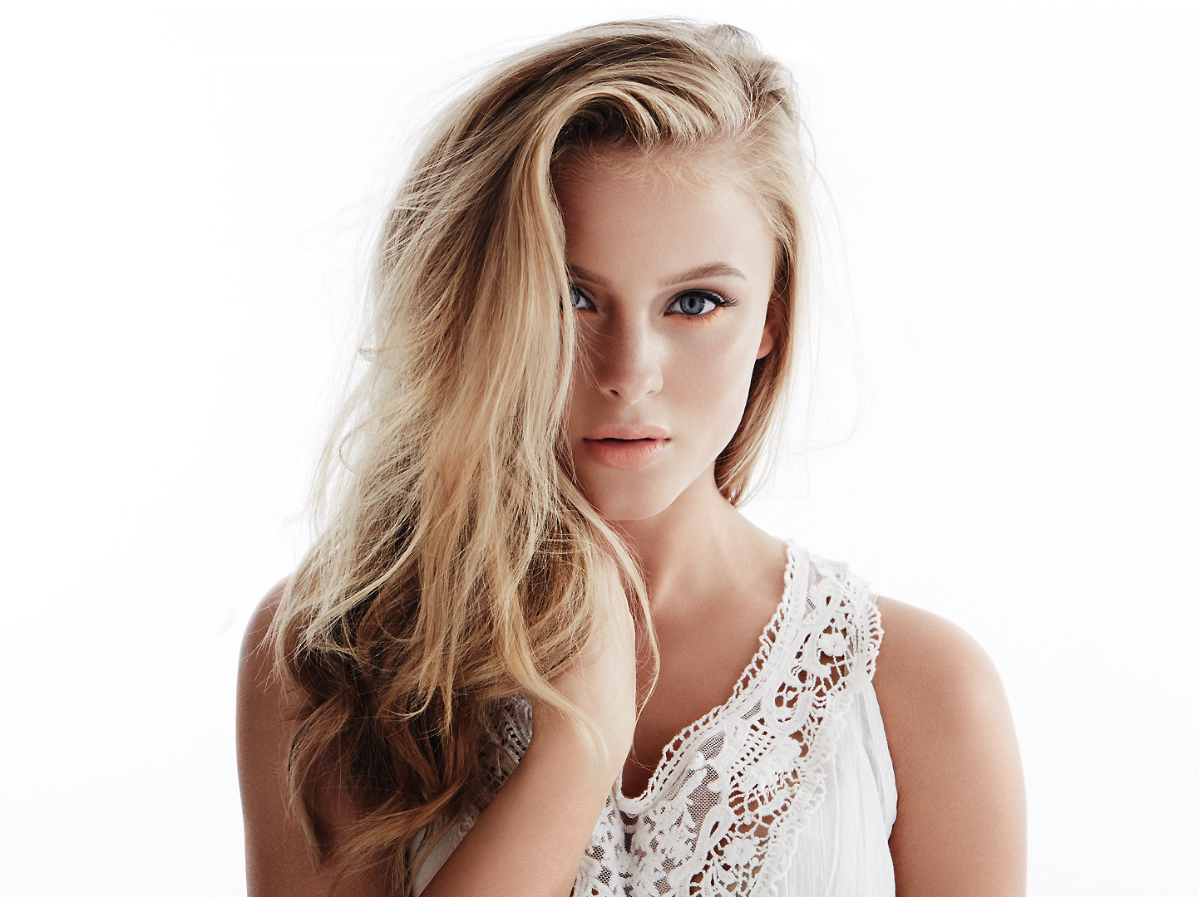
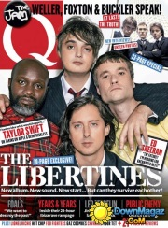
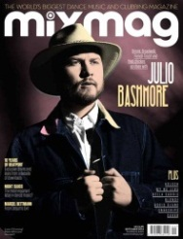
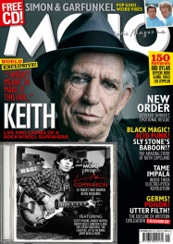
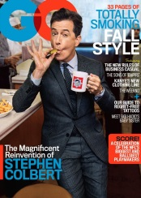
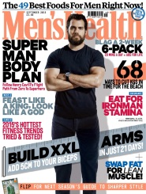
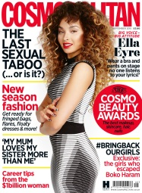
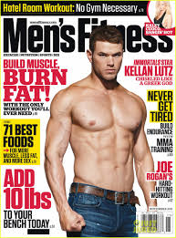
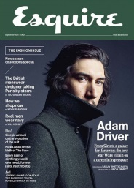
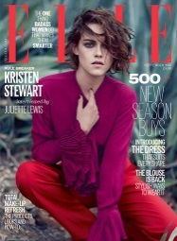
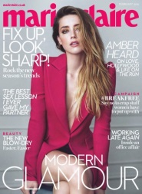
The Box channels reach more 16-34s each
month than popular magazines
4Music & Box 6 combined Monthly reach = 3.3m
Music/Film mags combined Monthly reach -Mixmag, Mojo, Q & Empire = 407k
Men’s mags combined Monthly reach –GQ, Men’s Health, Men’s Fitness & Esquire = 366k
Women’s mags combined Monthly reach –Glamour, Elle, Marie Claire & Cosmopolitan = 878k
Source: GB TGI 07/17-06/18 4Music & Box 6 : BARB/Advantedge Q3 2018

Slide 6
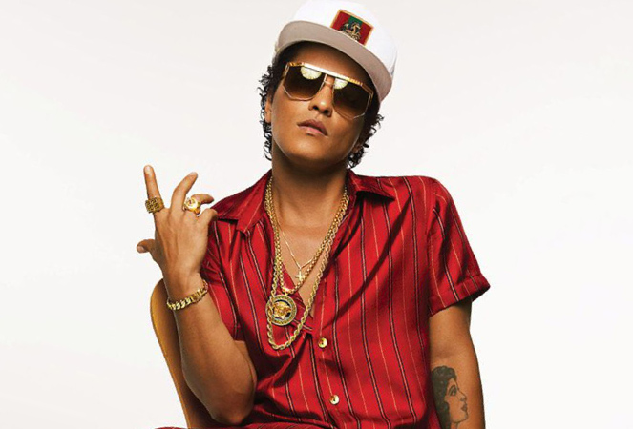
The typical 4Music Viewer
4Music viewers say they enjoy watching adverts as much as the programmes (i=194). They find TV advertising interesting and say it gives them something to talk about (i=183).
4Music viewers are commercially receptive, celebrities influence their purchase decisions (i=213) and they enjoy watching ads featuring their favourite celebrities (i=195).
Whilst watching TV they will also search on the internet for products they’ve seen advertised (i=196) and claim that advertising helps them choose what to buy (i=178).
Source: GB TGI 07/17-06/18 , base = adults. 4Music viewer defined as those who watched 4music or The Box in the last week.

Slide 7
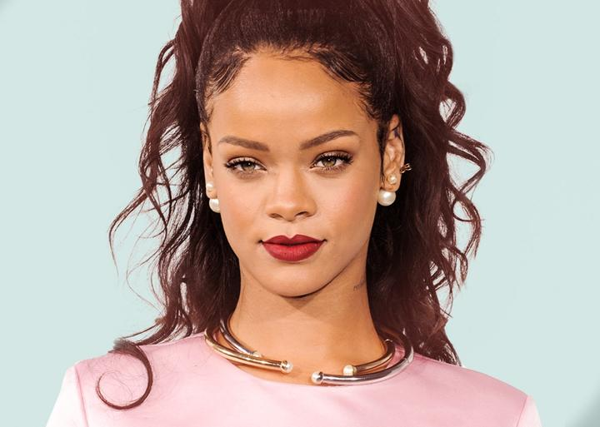
The typical 4Music Viewer
4Music viewers have premium tastes, saying they wear designer clothes (i=188), can’t resists expensive perfume/ aftershave (i=181) and have expensive tastes (i=147).
They are conscious of appearance – they like to stand out in a crowd (i=176) and they say designer labels improve a person’s image (i=187). They like to keep up with the latest fashions (i=178) and they spend a lot on clothes (i=188).
They are trendsetters – they buy new products before most of their friends (i=187) and are usually the first amongst their friends to know what’s going on (i=158). People come to them for advice before buying new things (i=158).
They are connected, saying they couldn’t live without internet on their mobile phone (i=138) and feel the need to check social networking sites every day (i=147).
Source: GB TGI 07/17-06/18 , base = adults. 4Music viewer defined as those who watched 4music or The Box in the last week.

