Slide 1
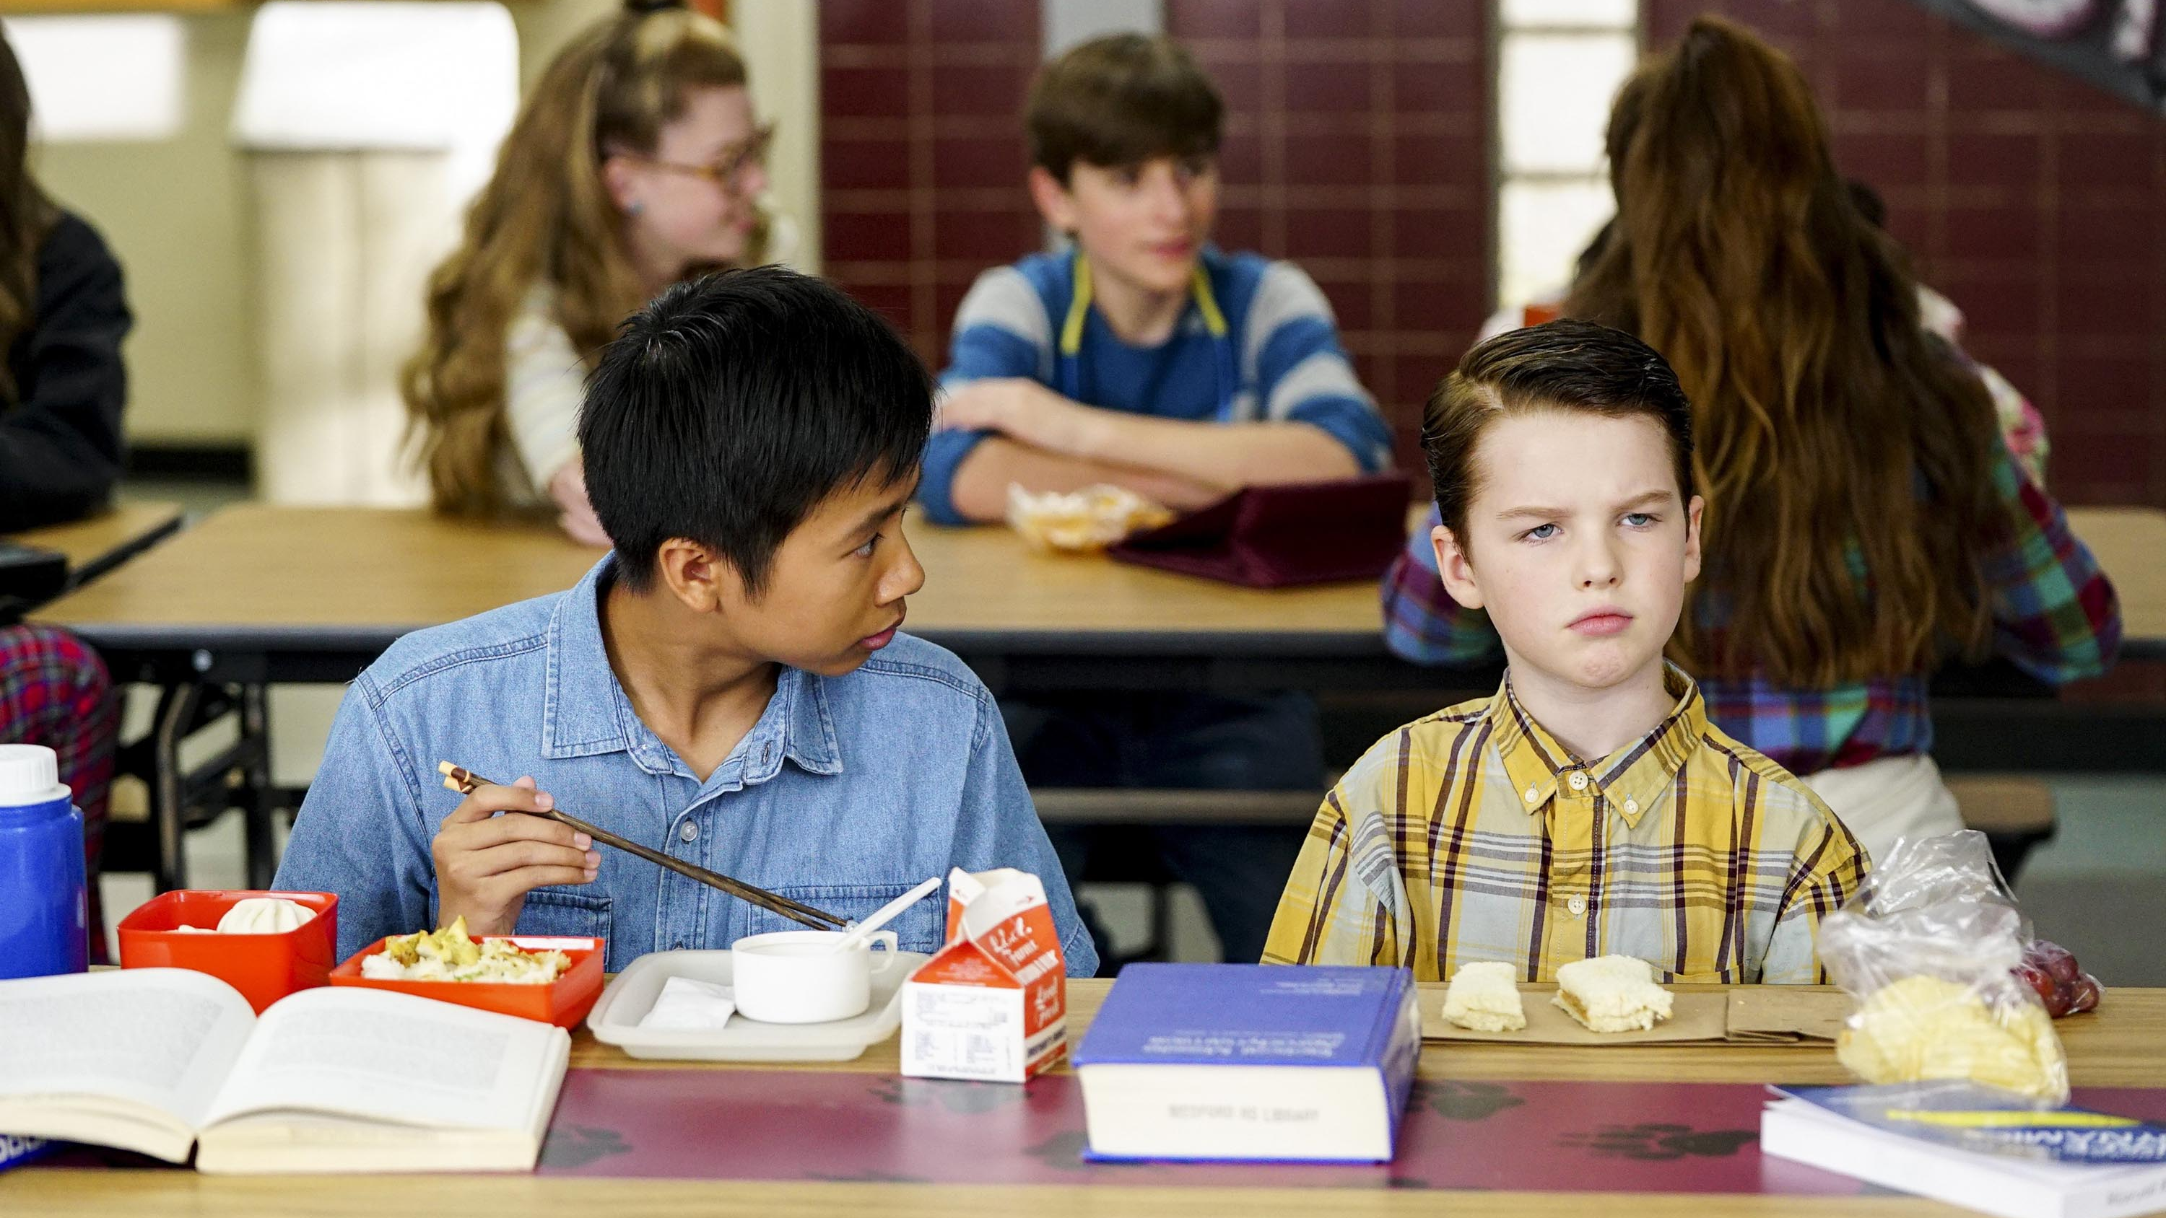
E4
Quarterly Update
Q1 2019

Slide 2
E4 Highlights
E4 took a 5.2% share of 16-34s in Q1, taking a higher share than ITV2, Channel 5, Sky1 and Comedy Central
E4 took an average peak share of 5.3% for for 16-34s in Q1, higher than ITV2 at 4.9%
E4 took a 1.6% share of adults
E4 has more than 5 times (2.8m) the amount of likes on Facebook than ITV2 (471k) and 25 times more than ITVBe (100K)
In peak time, E4 had an average weekly reach of 19.3% for 16-34s (2.8m)
For 16-34s, E4 (i=144) indexes much higher than Disney Channel (i=105), ITV2 (i=108), ITV Be (i=73), Sky One (i=90) and Sky Atlantic (i=46)
E4 reaches 42% of 16-34s a month (5.9m) and 39% of ABC1 16-34s (3.1m)
Sources: BARB/TechEdge Q1 2019 (peak share 1700-2300), *1+ reach, 3 mins continuous viewing

Slide 3
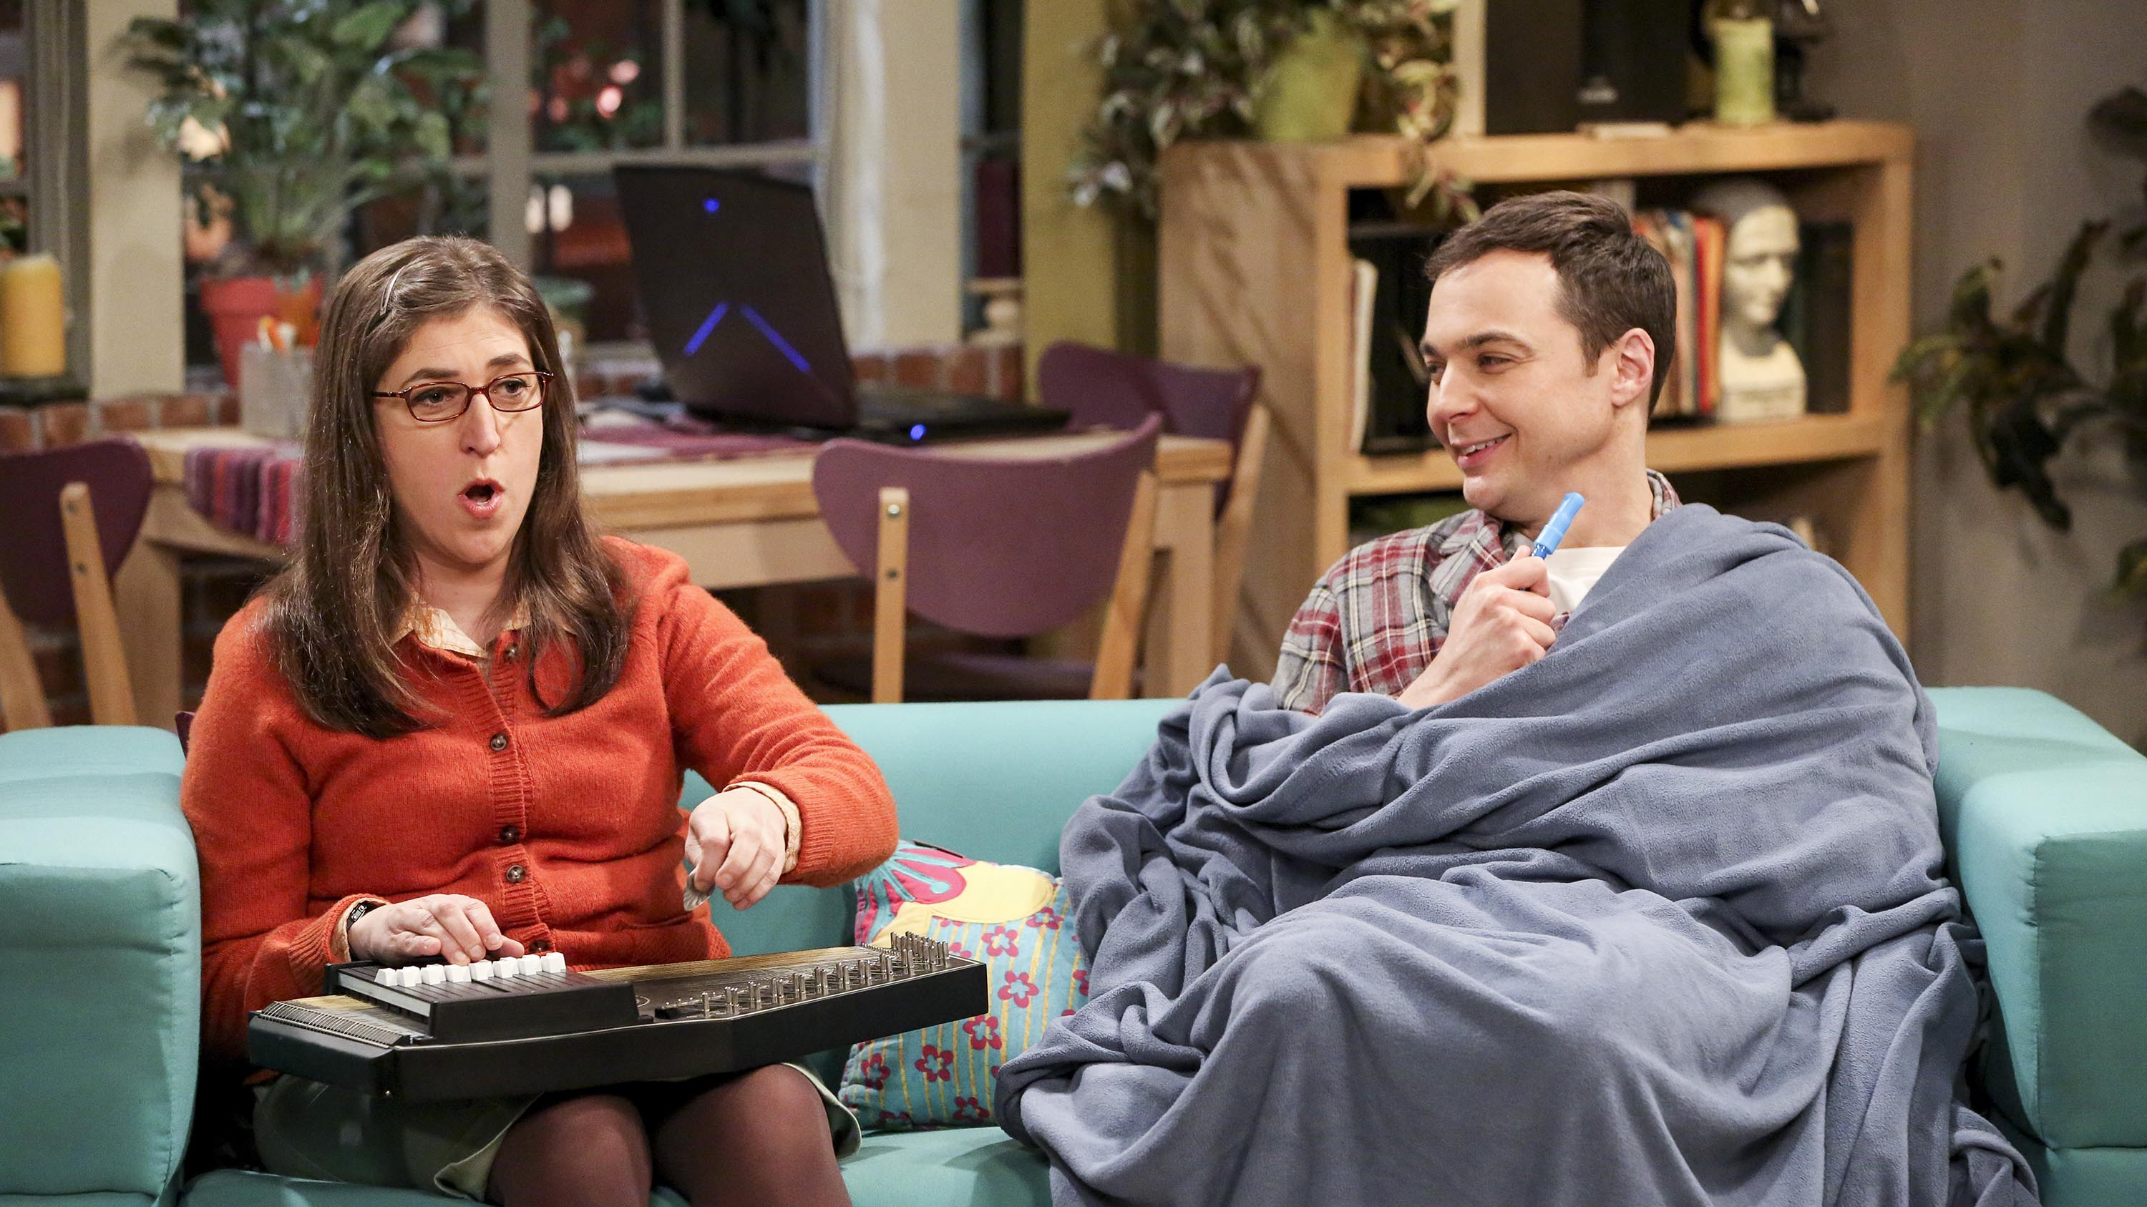
E4 is young and upmarket
upmarket
16+ audience profile (%):
%ABC1
downmarket
older
younger
%16-34
Source: BARB/TechEdge, Q1 2019, base: all adults, all time, size based on adult avg. audience (000s)

Slide 4
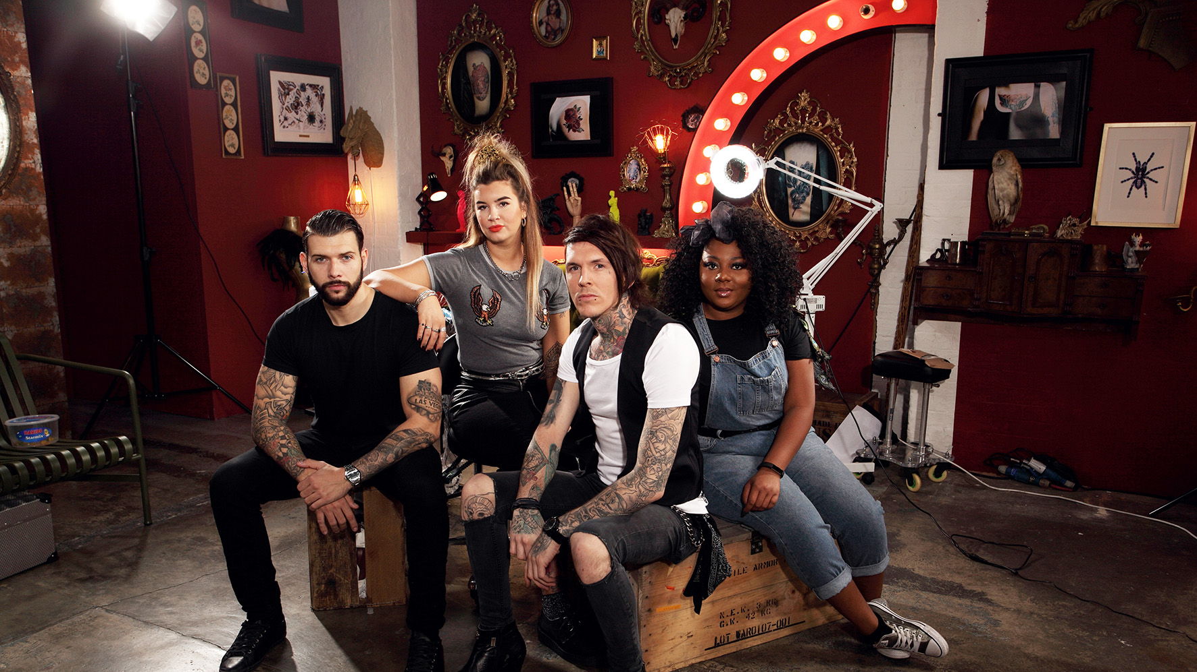
E4 has strong 16-34 reach
Source: BARB/TechEdge, Q1 2019, reach condition = minimum 3 consecutive mins viewing. ITV includes Breakfast + HD

Slide 5
E4 reaches more 16-34s than
competing media
By month vs. E4 (000s)
Source: *BARB/TechEdge, Q1 2019 Average Monthly reach 16-34s. minimum 3 mins consecutive viewing.
*TJD18T GB TGI 2019 Q1 (Oct 2017 - Sept 2018), 16-34s. AIR of magazines. Base = All Adults.

Slide 6
Audience Insight

Slide 7
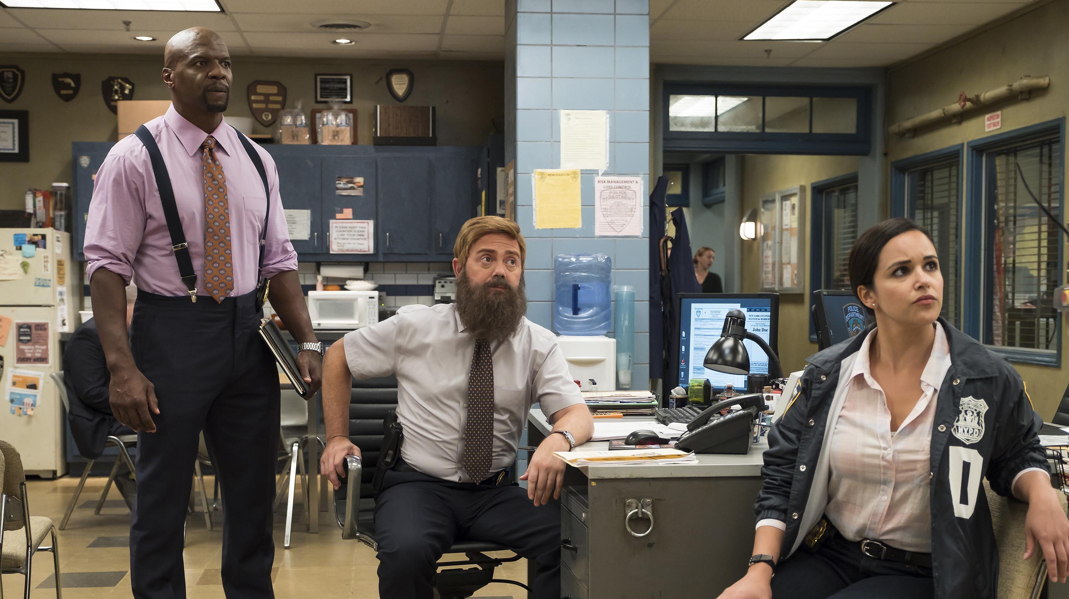
Top 10 biggest programmes
for 16-34s on E4
 | Programme title | Average 000s
1 | BROOKLYN NINE NINE | 608
2 | THE BIG BANG THEORY | 529
3 | HOLLYOAKS | 514
4 | CELEBS GO DATING | 483
5 | YOUNG SHELDON | 409
6 | SHIPWRECKED | 270
7 | THE GOLDBERGS | 263
8 | DEAD PIXELS | 257
9 | CELEBRITY COACH TRIP | 251
10 | MADE IN CHELSEA | 229
Source: BARB/TechEdge, Q1 2019, highest occurrence.

Slide 8
Top 10 converting programmes
for 16-34s on E4
 | Programme title | Index
1 | BROOKLYN NINE NINE | 288
2 | MELISSA & JOEY | 276
3 | HOLLYOAKS | 249
4 | THE GOLDBERGS | 245
5 | SPEECHLESS | 223
6 | THE INBETWEENERS | 218
7 | THE BIG BANG THEORY | 208
8 | DEAD PIXELS | 208
9 | FILM: ICE AGE (2002) | 206
10 | THE GREAT CELEBRITY BAKE OFF FOR SU2C | 206
Source: BARB/TechEdge, Q1 2019, highest occurrence. Index vs 16+. Minimum TVR 0.8 to allow adequate sample size

Slide 9
E4 viewers are ambitious, image
conscious & commercially receptive
E4 Viewers…
Are TV Addicts (i=147) who feel that because of online TV streaming, they watch more TV than they used to (i=146). They also feel that TV often inspires them to take up new interests (i=146) and influences their opinion (i=142)
They are ambitious and want to get to the very top in their career (i=153) and many would like to set up their own business one day (i=145)
They like looking good, spending a lot on toiletries and cosmetics for personal use (i=141) and spending a lot on clothes (i=138). They like experimenting with make-up to change their appearance (i=136)
They enjoy watching ads featuring their favourite celebs (i=132), they often notice product/brands on TV shows (i=141), are tempted to buy products they’ve seen advertised (i=140) and search for products they’ve seen advertised while watching TV (i=141)
They are trend setters, people come to them for advice before buying new things (i=140) and they love to buy new gadgets and appliances (i=134). They buy new products before most of their friends (i=132)
They are connected, feeling the need to check social media everyday (i=139)
They also like to eat take-away meals (i=133)
Source: TJD18T GB TGI 2019 Q1 (January - December2018), base = All Adults.. E4 viewer defined as 1st Fav Channel is E4; definitely agree/tend to agree with statements

