Slide 1


UKTV
Quarterly update, Q3 2018

Slide 2
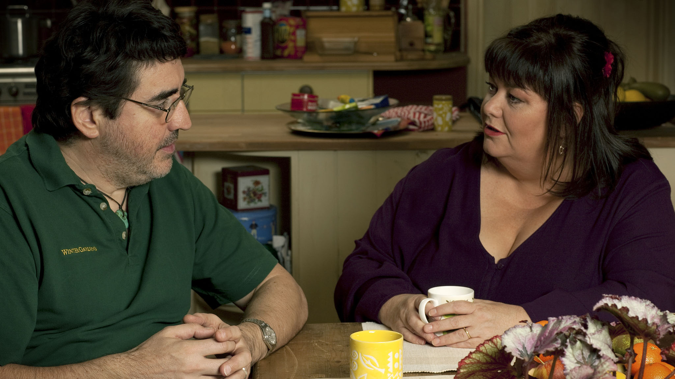


UKTV Highlights
Yesterday remains the biggest factual channel in the UK, bringing in 12m adults per month across Q3
UKTV took a 5.47% Share of Adults in 2018 Q3
In Q3 UKTV’s SOCI remains ahead of Sky and Channel 5 family channels
Over 7.3m adults tuned into Really every month on the Freeview platform, maintaining its position as the 4th highest non-PSB monthly reach in Freeview and ahead of 5Spike and Quest
This strong performance was driven by Drama, and Dave
Despite completing mandatory registration across all platforms, UKTV Play enjoyed a +50% increase in views YoY in Q3 2018, remaining UKTV’s fastest growing brand
Dave reached 17.7 million adults a month in Q3, with Taskmaster returning with its highest consolidated audience to date of 1.1m!
John Bishop: In Conversation With… returned for S4 in Q3, with the series averaging 125k (+127% vs slot) in addition to a stellar 71% ABC1 profile.
In Q3, Good Food reached 3.4m viewers a month, up +4% QoQ. The channel maintained a strong ABC1 profile (48% in Q3, up +12% QoQ)
Source: BARB/Advantedge, Q3 2018

Slide 3



Dave and Drama retained their places as the top two non-public service broadcasters in the UK
Q3 SOCI was 9.45%- YTD the network remains in an enviable position in the commercial market ahead of Sky and the Five family of channels
Notes:
network’s best day ever.

Slide 4

UKTV
Audience Insight
Q3 2018

Slide 5
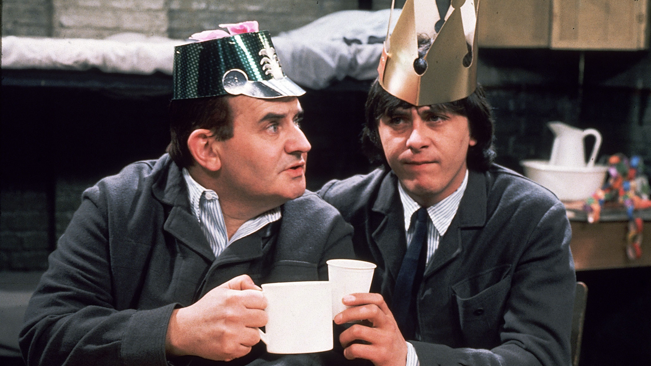
UKTV adds incremental reach
Monthly
Weekly
Source: BARB/Advantedge. Q3 2018, Av monthly and weekly reach. Reach condition = 3 consecutive mins.
Notes:
updated

Slide 6
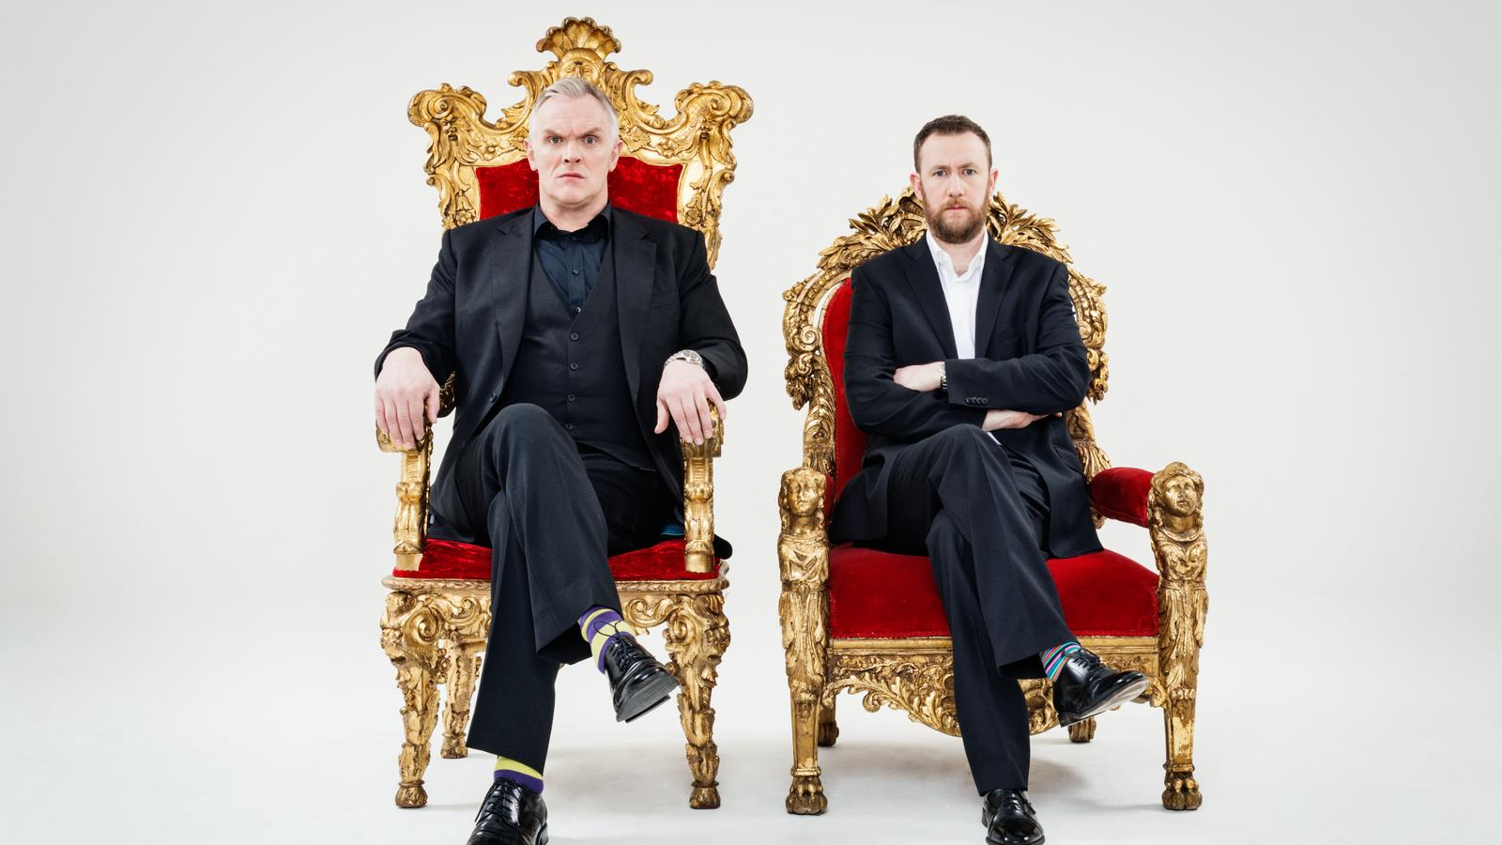
Highest Rating Programmes
16-34s
000s
1 | TASKMASTER | DAVE | 369.3
2 | JUDGE ROMESH | DAVE | 117.4
3 | MOCK THE WEEK | DAVE | 104.1
4 | TASKMASTER: CHAMPION OF CHAMPIONS | DAVE | 96.6
5 | TOP GEAR: VIETNAM SPECIAL | DAVE | 78.1
6 | LIVE AT THE APOLLO | DAVE | 75.8
7 | DEADLY 60 | DAVE | 70.1
8 | TOP GEAR | DAVE | 69.2
9 | MRS BROWN’S BOYS | GOLD | 68.8
10 | TIM VINE – THE JOKE AMOTIVE | DAVE | 67.5
Source: BARB/Techedge Q3 2018. Unique Main Title.
Notes:
updated

Slide 7
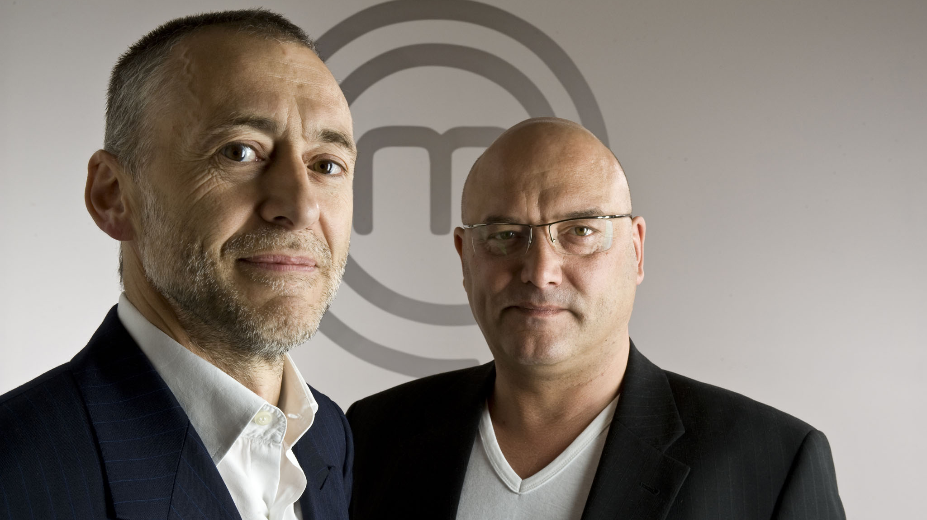
Highest Converting Programmes
16-34s
Index
1 | NATURE’S GREATEST DANCERS | EDEN | 352
2 | KILLER WHALE ISLAND WITH NIGEL MARVEN | EDEN | 347
3 | CRAZY CREATURES COSTUMES | EDEN | 298
4 | STACEY DOOLEY INVESTIGATES: NEW DRUG | W | 286
5 | WHO DO YOU THINK YOU ARE? | YESTERDAY | 283
6 | CHOCCYWOCCYDOODAH | W | 275
7 | SWEET BABY JAMES | GOOD FOOD | 256
8 | LIMMY’S SHOW | GOLD | 255
9 | THE PIGLET FILES | GOLD | 255
10 | GARDEN RIVALS | DRAMA | 242
Source: BARB/Techedge Q3 2018. Unique Main Title. Min TVR=0.3

Slide 8
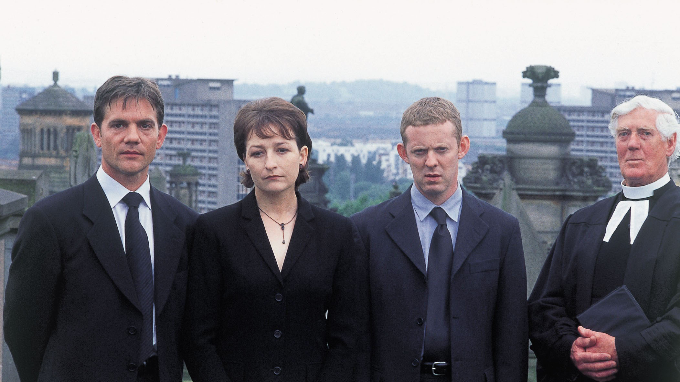
Highest Rating Programmes
50+
000s
1 | FATHER BROWN | DRAMA | 466
2 | REBUS | DRAMA | 412
3 | THE INSPECTOR LYNLEY MYSTERIES | DRAMA | 354
4 | DALZIEL AND PASCOE | DRAMA | 354
5 | MISS FISHER'S MURDER MYSTERIES | DRAMA | 349
6 | ABANDONED ENGINEERING | YESTERDAY | 349
7 | REBUS - THE NAMING OF THE DEAD | DRAMA | 328
8 | NEW TRICKS | DRAMA | 319
9 | LAST OF THE SUMMER WINE | DRAMA | 316
10 | DEATH IN PARADISE | DRAMA | 307
Source: BARB/Techedge Q2 2018. Unique Main Title.
Notes:
updated

Slide 9

Highest Converting Programmes
50+
Index
1 | TOO GOOD TO EAT | GOOD FOOD | 211
2 | REBUS – BLACK AND BLUE | ALIBI | 211
3 | FRANKIE DRAKE MYSTERIES | ALIBI | 211
4 | MILLY’S COOKBOOK: WINTER WARMERS | GOOD FOOD | 211
5 | GONE, BUT NOT FORGOTTEN | DRAMA | 211
6 | DINO HUNT | EDEN | 211
7 | SIMON RIMMER’S DINNERS | GOOD FOOD | 211
8 | JAMES MARTIN: YORKSHIRE’S FINEST | GOOD FOOD | 211
9 | CREATURE COMFORTS | GOLD | 211
10 | FINDING LIFE BEYOND EARTH | EDEN | 211
Source: BARB/Techedge Q3 2018. Unique Main Title. Min TVR=0.3
Notes:
updated

Slide 10

Highest Rating Programmes
ABC1 Adults
000s
1 | TASKMASTER | DAVE | 694
2 | MURDER ON THE BLACKPOOL EXPRESS | DRAMA | 320
3 | JUDGE ROMESH | DAVE | 247
4 | FATHER BROWN | DRAMA | 228
5 | WOULD I LIE TO YOU? | DAVE | 227
6 | DEATH IN PARADISE | DRAMA | 225
7 | ROOM 101 | DAVE | 192
8 | THE HEART GUY | DRAMA | 188
9 | INSIDE THE AMBULANCE | REALLY | 187
10 | SHERLOCK | DRAMA | 187
Source: BARB/Techedge Q3 2018. Unique Main Title.
Notes:
updated

Slide 11

Highest Converting Programmes
ABC1 Adults
Index
1 | CREATURE COMFORTS | GOLD | 180
2 | BUSH PILOTS | EDEN | 180
3 | DEADLIEST PESTS DOWN UNDER | EDEN | 180
4 | LIFE IN THE AIR | EDEN | 180
5 | EDEN SHORTS 2015 | EDEN | 180
6 | ONE WAY ASTRONAUT | EDEN | 180
7 | COUNTDOWN TO A CATASROPHE | EDEN | 180
8 | EDEN SHORTS 2014 | EDEN | 180
9 | HARRY HILL’S TV BURP | GOLD | 180
10 | TORNADO ALLEY | EDEN | 180
Source: BARB/Techedge Q3 2018. Unique Main Title. Min TVR=0.3

Slide 12

Highest Rating Programmes
Men
000s
1 | TASKMASTER | DAVE | 650
2 | JUDGE ROMESH | DAVE | 297
3 | MURDER ON THE BLACKPOOL EXPRESS | DRAMA | 201
4 | VIKING DEAD | YESTERDAY | 199
5 | DEATH IN PARADISE | DRAMA | 195
6 | HAVE I GOT A BIT MORE NEWS FOR YOU | DAVE | 191
7 | MODERN WHEELS OR CLASSIC STEALS | DAVE | 186
8 | ‘ALLO ‘ALLO! | YESTERDAY | 185
9 | ROOM 101 | DAVE | 180
10 | LAST OF THE SUMMER WINE | DRAMA | 177
Source: BARB/Techedge Q3 2018. Unique Main Title.
Notes:
updated

Slide 13
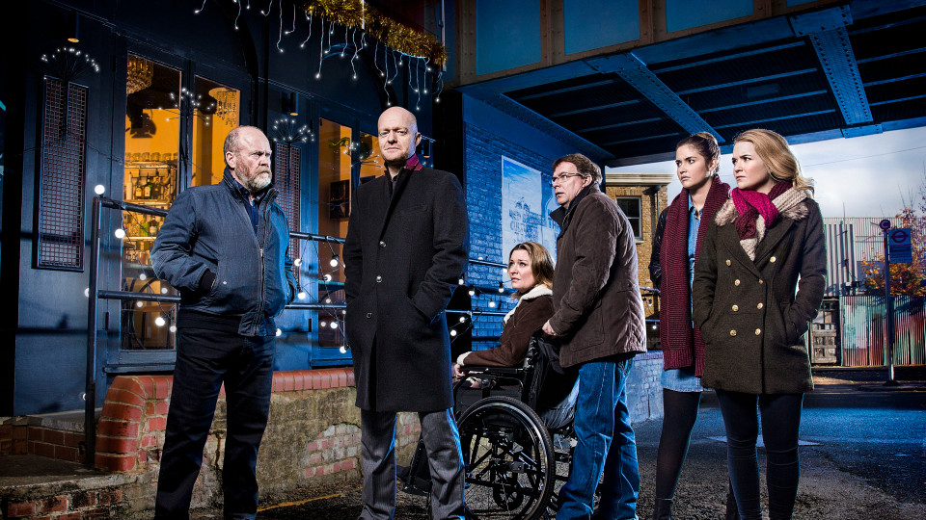
Highest Converting Programmes
Men
Index
1 | THE BRUVS | DAVE | 206
2 | INFESTATION | EDEN | 206
3 | SHOWDOGS | REALLY | 206
4 | HESTON’S GOURMET ESCAPE | GOOD FOOD | 206
5 | RAIDERS OF THE LOST ART | YESTERDAY | 206
6 | THE ARMANDO IANNUCCI SHOWS | GOLD | 205
7 | URANIUM: TWISTING THE DRAGON’S TAIL | EDEN | 205
8 | OXFORD STREET REVEALED | REALLY | 205
9 | BLITZ TSREET | YESTERDAY | 205
10 | COMIC STRIP PRESENTS… | GOLD | 205
Source: BARB/Techedge Q3 2018. Unique Main Title. Min TVR=0.3
Notes:
updated

Slide 14

UKTV
Channel analysis
Q3 2018

Slide 15












Dave reached 17.7 adults per month, with Taskmaster kicking off series 7 with it’s highest-rating TX to date, entertaining an outstanding 1.3m
Drama maintains the #1 non-PSB channel in the UK with a 1.28% share in Q3, averaging 10.4m adults on average per month across the quarter
Much-loved favourites continue to deliver for the channel with Mrs Brown’s Boys sitting as the best performing show of the quarter, peaking at 285k
W reached 8.4m adults a month in Q3 2018, the 3rd highest for a Pay Only Entertainment channel and ahead of Comedy Central
Inside the Ambulance S2’s Freeview premiere delivered Really’s highest ever audience for a documentary of 361k
alibi’s loyal audience delivered an average monthly frequency of 4.1 in Q3, the highest this year and above all competitors among Pay Ent channels
Yesterday delivered it’s best Q3 since 2012, seeing share up +10% YoY averaging 0.73%
Eden reached 1.5m adults a month in Q3, up +12% QoQ, above H2 and Animal Planet
In Q3, Good Food reached 3.4m viewers a month, up +4% QoQ while maintaining an enviable ABC1 profile (48%, up +12% QoQ)
Home saw it’s highest ever rating TX in Q3 2018 with Bargain Hunt’s 172k.
UKTV Play had another great quarter in Q3, up +50% YoY, buoyed by Taskmaster S7.
*Including tagged preview data as collated by Digital-i.

Slide 16

Monthly Reach
Source: BARB/Advantedge. Q3 2018, Av monthly and weekly reach. Reach condition = 3 consecutive mins.
Notes:
updated

Slide 17
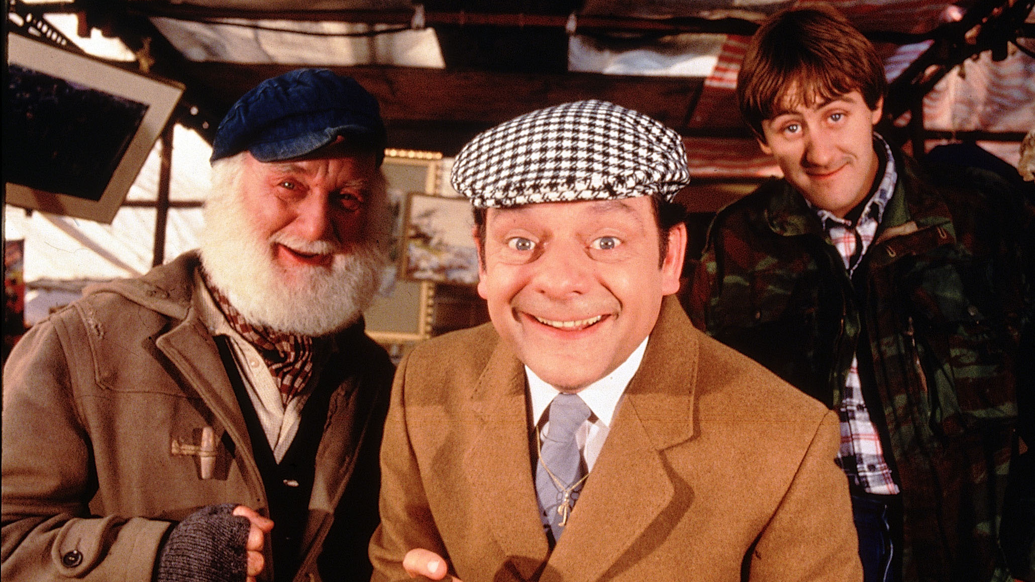
Monthly Reach
Source: BARB/Advantedge. Q3 2018, Av monthly and weekly reach. Reach condition = 3 consecutive mins.
Notes:
updated

Slide 18


alibi offers viewers a masterclass in deduction. Sit back and spend your time puzzle solving with the world’s greatest minds. We believe solving crime is not just a science but an art form, it about gut feeling with deductive analysis.
If you love the thrill of the chase, knitting all the clues together, love the satisfaction of finding the last piece of the puzzle to solve the story then we’ve got something for you. We have the best quality crime dramas to test your skills of deduction, featuring handpicked crime drama such as Father Brown, Murdoch Mysteries and Death in Paradise.
With an 0.39% share, alibi became the 6th biggest pay only entertainment channel in Q3, ahead of Universal, Fox and Sky Atlantic
The channel’s loyal audience delivered an average monthly frequency of 4.1 in Q3, its highest this year, overtaking all competitors among the Pay Ent channels
With 26 min 42 sec average session length in Q3, alibi was 3rd only to Universal and Comedy Central among the Pay Ent channels.
Profile source: BARB/Advantedge, Q3 2018 Base Ads 16+
ABN TV not considered key competitor
Notes:
Session length excludes Universal (as they don’t report ad breaks)

Slide 19
The channel’s loyal audience delivered an average monthly frequency of 4.1 in Q3, its highest this year, overtaking all competitors among the Pay Ent channels.
Ep 1 of new and exclusive Harrow pulled in a consolidated high of 432k between its 2am preview and 9pm premiere on 17th July, making it the most successful launch on the channel this year and the best new programme launch since Quantico S1 back in March 2016
alibi continued to benefit from the launch of new shows in Q3: Ten Days in the Valley and The Assets ranking amongst top programmes
Ep 5 of new to alibi The Coroner S2 pulled in a consolidated high of 221k on 2nd July, providing +70% improvement vs slot average whilst 4th July ep 4 of new and exclusive Carter consolidated to 196k, +249% up on slot average.
Top Programmes
Quarter-on-Quarter performance (16+ share)
2018 Q3 Top programmes, ranked by max 000s (16+)
Source: BARB/Advantedge, Jan 2017 - Sep 2018 Base Ads 16+
Source: BARB/Advantedge, Q3 2018, Base Ads 16+.

Slide 20

Alibi viewers…
Are TV addicts (index 141) and watching TV is their favourite past-time (index 130), with them relying on TV to keep informed (index 126).
They enjoy ads as much as programmes (index 132), they think TV ads are the most useful in helping with their purchase decisions (index 133) and often buy products from companies who sponsor TV programmes (index 132).
If they trust a brand they’ll buy it without looking at the price (index 109), and tend to buy new products before most of their friends (index 121).
When they see a new brand they often buy it to see what it’s like (index 110), they often notice brands/products that appear in TV programmes (index 110) and search on the internet for these products whilst watching TV (index 117).
Source: GB TGI 2018: 07/17-06/18: watched Alibi within the last week.

Slide 21

Dave is the place to reach men
Dave reaches 1.1m and 2.4m more ABC1 men than Sky 1 and Sky Sports Main Event respectively,
and 609K and 1.1m more 16-34 men than Comedy Central and Sky Sports Main Event respectively
Source: BARB/Advantedge. Q3 2018 Av monthly reach. Reach condition = 3 consecutive mins. Digital male competitor channels
Notes:
updated
Stats:
In Q1 Dave targeted the younger audience;
Among channels over 1% adult share Dave is 3rd, only behind ITV2 and E4 for 16-34 % profile.
Among a declining 16-34 market Dave was also the only channel over 1% adult share to retain it’s 16-34 % profile vs. FY 2016. E4 down -3% and ITV2 down -5%.
16-34 have seen boosts this year with the highest day’s profile since May 21st 2016 at the beginning of April (38% 16-34 on Sunday 2nd 2017).
W/D Daytime also seeing improvements with younger audiences, averaging 28% 16-34 in March.
Elsewhere, Dave’s commission Taskmaster has been nominated for a Bafta Award. Returning commission’s Unspun brought in a strong ABC1 profile (58%) while Crackanory drove younger audiences (30% 16-34s).

Slide 22

Dave adds wit to your world by bringing you not just comedy but entertainment and even some knock-out live sport. Hit UKTV Original commissions include Taskmaster, and Judge Romesh all laden with the biggest names in British comedy. This quarter the channel has continued to grow its commissioning slate, with Judge Romesh and the return of Taskmaster which had it’s most successful launch ever (1.3m). We also continue to bring the best of classic entertainment with shows such as Top Gear, QI and Mock the Week.
Dave was the #2 non-PSB in Q3 2018
Dave had the highest monthly reach among non-PSBs on all platforms, reaching 17.7 million adults a month in Q3, reaching over 5.5m more adults per month than the #2 non-PSB (Pick)
The channel reached 9m ABC1s a month and 3.9m 16-34s a month in Q3.
Profile source: BARB/Advantedge, Q3 2018 Base Ads 16+
Source: TechEdge/Barb – Reach 3min, 1+ (Q3 18) Growth is YoY Share (2018 vs 2017).

Slide 23
Taskmaster kicked off series 7 with it’s highest-rating TX to date, entertaining an outstanding 1.3m.
Taskmaster S7 returned in September and drew it’s highest consolidated audience ever, launching with 1.3m, a 63% ABC1 profile and 33% 16-34s
Judge Romesh launched in Q3 to an audience of 929k* individuals, and across Q2 the series averaged a 20% 16-34 and 51% ABC1 profile
Modern Wheels or Classic Steals launched in September to 164k with a 42% ABC1 profile.
Top Programmes
Quarter-on-Quarter performance (16+ share)
 | 2017 | 2018 | YoY
Q1 | 1.08 | 1.11 | 3%
Q2 | 1.12 | 1.14 | 2%
Q3 | 1.12 | 1.02 | -9%
Q4 | 1.13
YTD | 1.10 | 1.09 | -1%
2018 Q3 Top programmes, ranked by max 000s (16+)
Source: BARB/Advantedge, Jan 2017 - Sep 2018 Base Ads 16+
Source: BARB/Advantedge, Q3 2018, Base Ads 16+. *Including tagged preview data as collated by Digital-i.

Slide 24
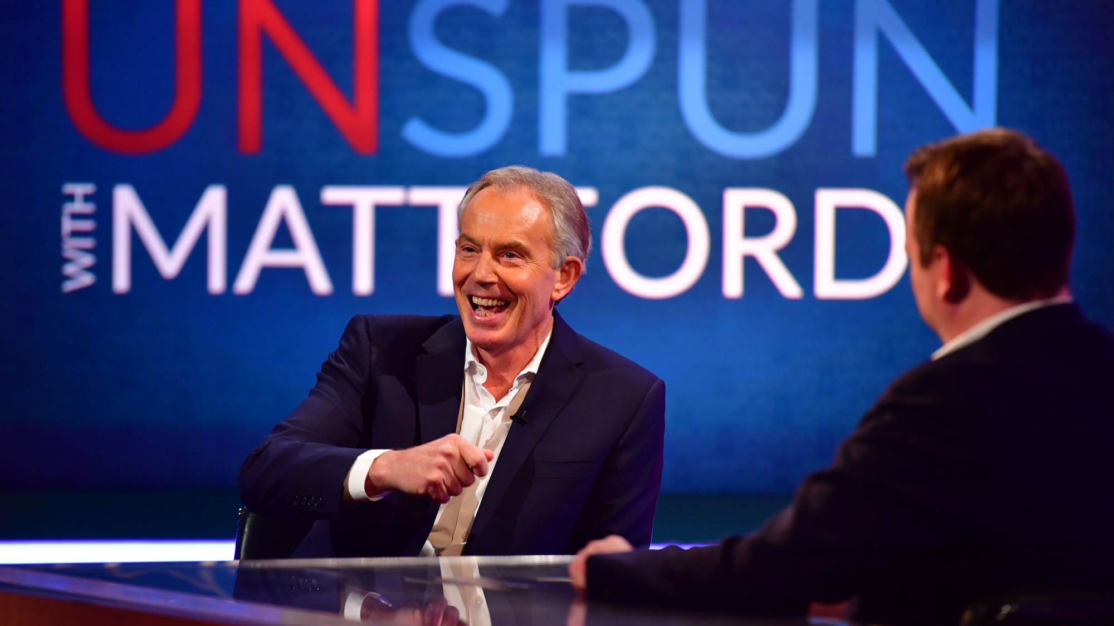
Dave viewers…
Pay the most attention to TV adverts (Index: 124) and find them most useful in making purchase decisions (Index 118) as well as often noticing products/brands in TV programmes/film (Index: 111)
They love to buy new gadgets and appliances (Index: 113) and try to keep up with developments in technology (Index: 111). People often come to them for advice before buying new things (Index: 107).
They often do things on the spur of the moment (Index: 104), such as listening to new bands (Index: 107), or trying out new food products (Index: 108). They agree it’s worth paying extra for good quality beer and wine (Index: 112).
Source: GB TGI 2018: 07/17-06/18, watched Dave within the last week.

Slide 25


Drama is a treasure trove of Britain’s best loved drama.
This is the channel for those that believe that nothing beats the thrill of a good drama; the anticipation, the tension and the twists . Get some quality escapism here. From period through to contemporary and comedy, we have a broad range of drama to suit every taste. With programmes such as Call The Midwife, New tricks, Sharpe, The Inspector Lynley Mysteries and Classic Eastenders– viewers will feel like they can sit back and relax with drama.
Drama maintains it’s strong position in the market, ranked the #1 non-PSB channel in the UK with a 1.28% share in Q3.
The channel reached a high number of viewers - 10.4m adults on average per month across the quarter
Drama’s loyal audience delivered an average monthly frequency of 4.85 in Q3, with July seeing a peak for this year with an average frequency of 5.2.
Profile source: BARB/Advantedge, Q3 2018 Base Ads 16+

Slide 26
Sunday 26th August attracted an impressive 1.90% share making it the best day ever for the channel outside of the Christmas period.
UKTV Original Murder on the Blackpool Express was a standout hit for Drama on Sunday 26th August, consolidating to 634k (+216% vs. slot). The Summer Stunt boosted weekends across July and August, with Sunday 26th August attracting an impressive 1.90% share making it the best day ever for the channel outside of the Christmas period.
New to Drama series of popular titles pulled in high numbers in peak, e.g. Death in Paradise was viewed by 455k, +32% on 24th Sep
Father Brown remained a popular title amongst Drama viewers: S3 ep10 pulled in 475k on Friday 20th July, +29% vs slot whilst 14th Sep broadcast of episode from new to Drama series was viewed by 439k, + 23%.
Top Programmes
Quarter-on-Quarter performance (16+ share)
2018 Q3 Top programmes, ranked by max 000s (16+)
Source: BARB/Advantedge, Jan 2017 - Sep 2018 Base Ads 16+
Source: BARB/Advantedge, Q3 2018, Base Ads 16+.

Slide 27


Drama viewers…
Are TV addicts (Index: 113), watching TV is their favourite pastime (Index: 113), and they rely on TV to keep informed (Index: 121)
Of all advert types, they pay the most attention to TV ads (Index: 126) and find TV ads the most useful in helping them make a purchase decision (Index: 122).
They enjoy the adverts as much as the programmes on TV (Index: 105) and think it is important to be well informed about things (Index: 104).
Source: GB TGI 2018: 07/17-06/18, watched Drama within the last week.

Slide 28


Wonder at Our World
Eden guarantees a daily shot of astonishment and high quality natural science programming. Programmes on Eden feature some of the UK’s most respected natural history, science and adventure presenters including Sir David Attenborough, Professor Brian Cox, Nigel Marven, and Iain Stewart.
Eden reached 1.5m adults a month in Q3, up +12% QoQ, above H2 and Animal Planet
Eden’s average session length grew +3% QoQ to 23.5 mins
ABC1 Profile averaged 43% for the quarter, up +8% QoQ.
Profile source: BARB/Advantedge, Q3 2018 Base Ads 16+

Slide 29
Eden reached 1.5m adults a month in Q3, up +12% QoQ, above H2 and Animal Planet.
Top Programmes
Quarter by Quarter Share Performance (16+ share)
2018 Q3 Top programmes, ranked by max 000s (16+)
Source: BARB/Advantedge, Jan 2017 – Sep 2018 Base Ads 16+
Source: BARB/Advantedge, Q3 2018, Base Ads 16+.

Slide 30

Eden viewers…
Are TV addicts (index 197) and say that watching TV is their favourite pastime (index 159). Whilst watching TV they search on the internet for products they see advertised (index 187) and enjoy TV ads as much as programmes (index 280).
They tend to buy products from companies who sponsor TV programmes (index 392). They say that advertising helps them choose what they buy (index 207) they also enjoy ads that feature their favourite celebrities (index 198) and say that celebs influence their purchase decisions (index 296).
They say a designer label improves a person’s image (index 230), they spend a lot on clothes (index 167), wear designer clothes (index 188) and can’t resist expensive perfume/aftershave (index 193). They also like to stand out in a crowd (index 234 ), keep up with the latest fashions (index 172) and buy new products before most of their friends (index 225)
They think it’s important that their household is equipped with the latest technology (index 182), tend to go for premium rather than standard goods/services (index 183) and spend money without thinking (index 160).
Source: GB TGI 2018: 07/17-06/18, watched Eden within the last week.

Slide 31
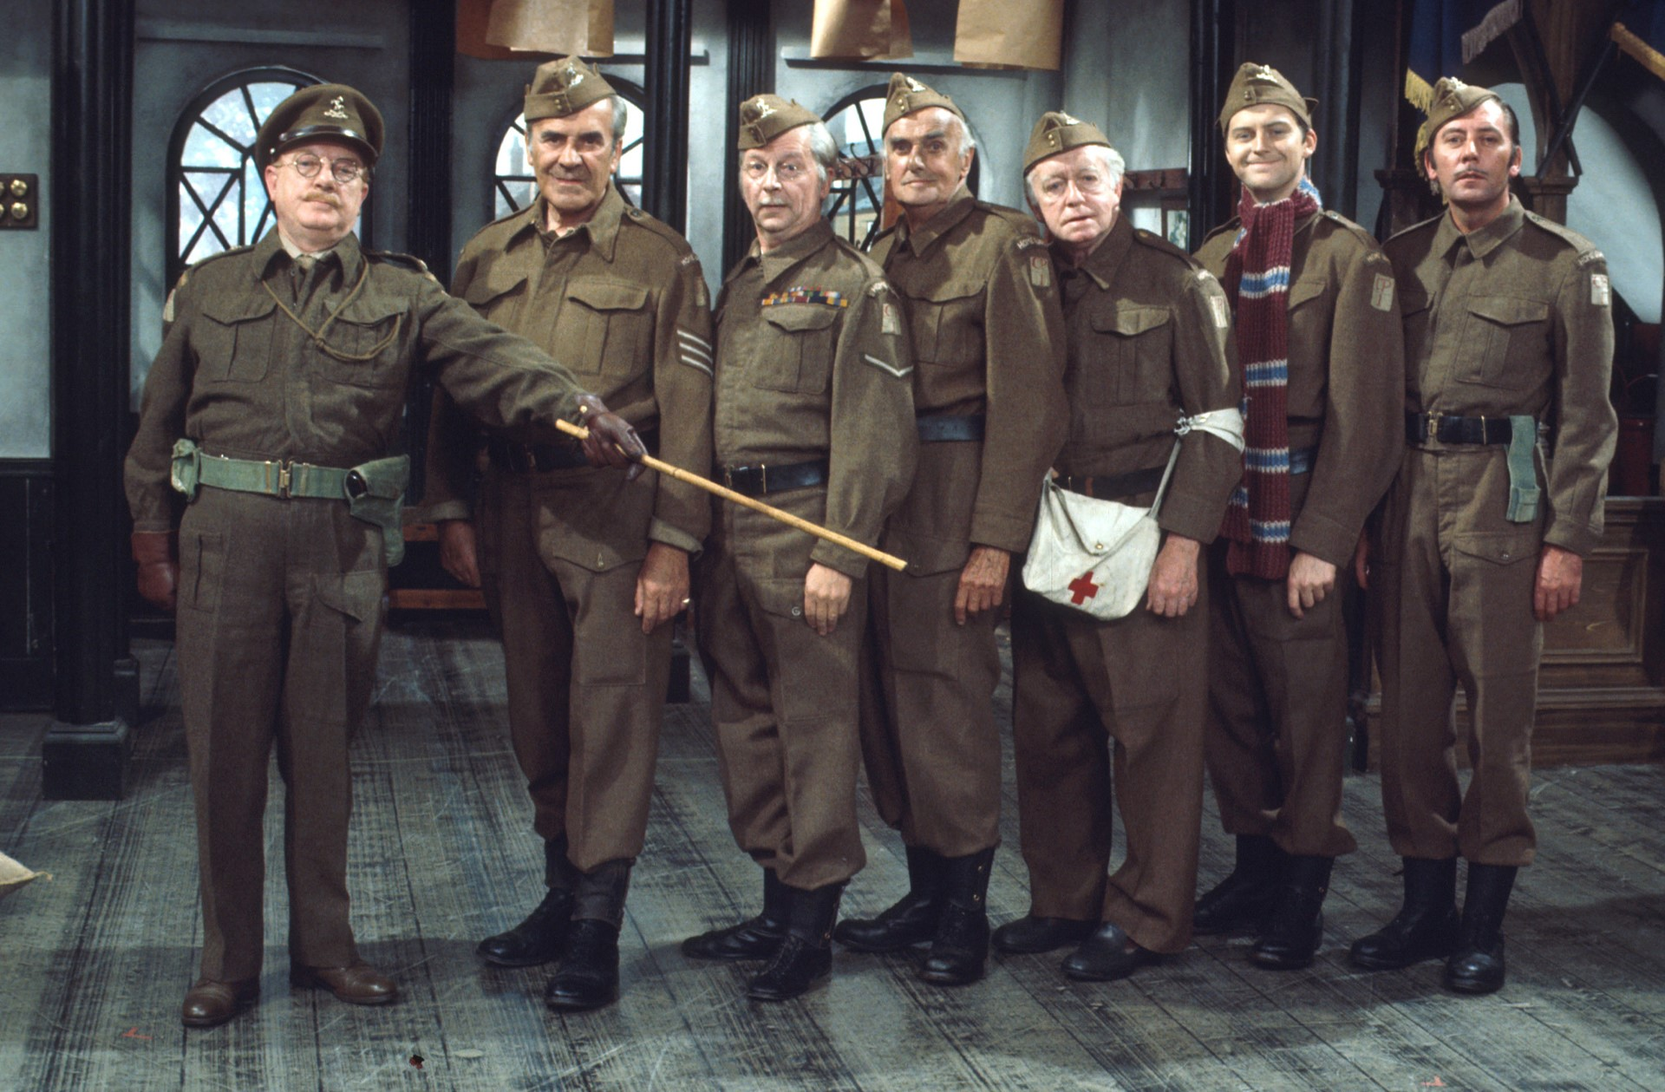

The Best in British Comedy, Gold offers guaranteed laughter whenever you visit. Dedicated to celebrating comedies you can enjoy watching together with the whole family, Gold’s much-loved British sitcoms such as Only Fools and Horses and The Vicar of Dibley sit alongside modern classics Gavin and Stacey, Mrs Brown’s Boys and more. Gold is also committed to creating fantastic new programmes, with successful premieres including Murder on the Blackpool Express, dinnerladies diaries and The Story of Only Fools and Horses.
Gold was the 3rd biggest pay entertainment channel in Q3 with a 0.48% share
In Q3, 8.1 million viewers tuned into Gold every month
Gold saw a strong ABC1 Male profile (25%) in Q3, up +9% QoQ.
Profile source: BARB/Advantedge, Q3 2018 Base Ads 16+
Source: TechEdge/Barb – Reach 3min, 1+ (Q3 18) Growth is YoY Share (2018 vs 2017).

Slide 32


GOLD’s Q3 saw a share of 0.48%, and was the 3rd biggest pay only entertainment channel
Dad’s Army continued in Q3, peaking on it’s 50th Anniversary with an audience of 224k, up +65% vs slot
Much-loved favourites continue to deliver for the channel with Mrs Brown’s Boys sitting as the best performing show of the quarter, peaking at 285k, up +252% vs slot
Q3 saw Only Fools and Horses average an ABC1 profile of 41% across the quarter.
Top Programmes
Quarter-on-Quarter performance (16+ share)
Source: BARB/Advantedge, Q3 2018 Base Ads 16+
Source: BARB/Advantedge, Jan 2017 - Sep 2018 Base Ads 16+
Source: BARB/Advantedge, Q3 2018, Base Ads 16+.

Slide 33



Gold viewers…
Are TV addicts (Index 128), watching TV is their favourite pastime (Index 121) and rely on TV to keep informed (Index 114).
They find TV adverts interesting and feel it gives them something to talk about (Index 110), while watching TV they search on the internet for products they have seen advertised (Index 124), they pay more attention to TV ads than any other type of advertising (Index 136) and find TV adverts the most useful in helping them make a purchase decision (Index 141).
They think a designer label improves a person’s image (Index 108) and they tend to go for premium rather than standard goods/services (Index 105). When they see a new brand they often buy it to see what it’s like (Index 105).
Source: GB TGI 2018: 07/17-06/18, watched GOLD within the last week.

Slide 34
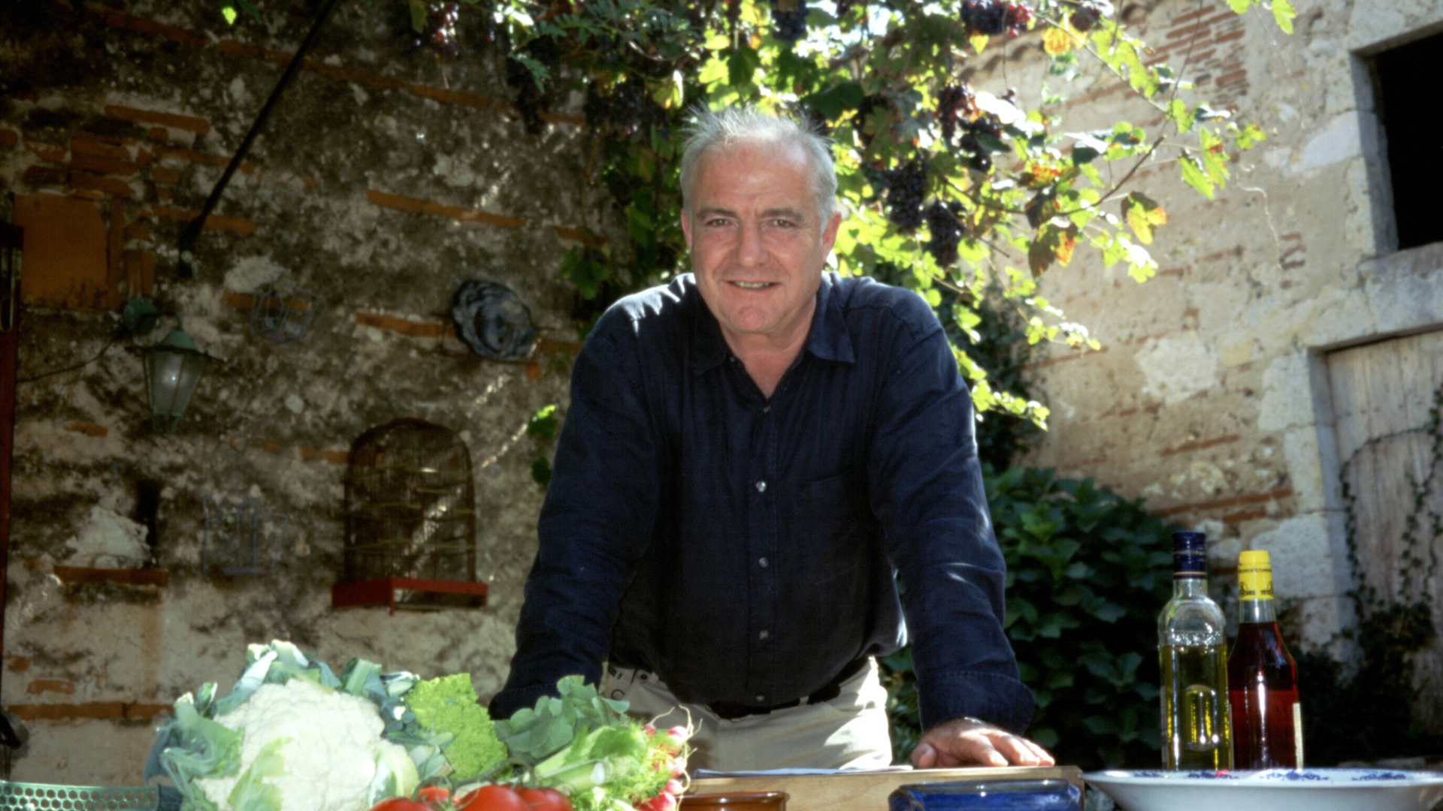

Passion on a plate
Good Food is the place to be for fabulous, entertaining food shows that showcase the best of food from around the world. Giving our audience access to high-calibre talent such as Rick Stein, James Martin, the Hairy Bikers and Jamie Oliver as well as introducing new and exciting food talent to the UK.
In Q3, Good Food reached 3.4m viewers a month, up +4% QoQ
The channel maintained a strong ABC1 profile (48% in Q3, up +12% QoQ)
Average monthly frequency was 3.2 and has continued to increase, up +11% YoY.
Profile source: BARB/Advantedge, Q3 2018 Base Ads 16+

Slide 35
Good Food attracted an 0.17% share in Q3 maintaining it’s enviable ABC1 profile.
Rick Stein titles continued to perform consistently well for Good Food, making up 4 of the top 10 programmes. In Q3, Rick Stein highlights included Fresh Food averaging a 72% ABC1 profile, French Odyssey 71% and Long Weekends 63%.
Top Programmes
Quarter-on-Quarter performance (16+ share)
2018 Q3 Top programmes, ranked by max 000s (16+)
Source: BARB/Advantedge, Jan 2017 – Sep 2018 Base Ads 16+
Source: BARB/Advantedge, Q3 2018, Base Ads 16+.
Notes:
Do pay share

Slide 36
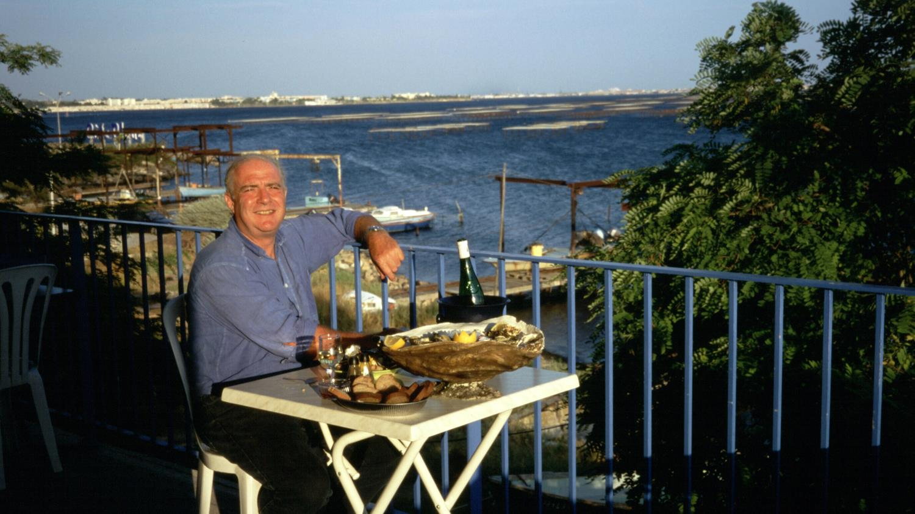
Good Food viewers…
They are TV addicts (index 133) and enjoy TV ads as much as programmes (index 168) and find them interesting to talk about (index 151).
They tend to buy products from companies who sponsor TV programmes (index 175), while watching TV they search on the internet for products they see advertised (index 168) and say advertising helps them choose what to buy (index 144).
They like to try new out new food products (index 132), go to trendy places to eat and drink (index 156), and spend money without thinking (index 122). They think it’s important that their household is equipped with the latest technology (index 113) and love to buy new gadgets and appliances (index 120).
They have expensive tastes (index 131), spend a lot on clothes (index 110), wear designer clothes (index 141), keep up with the latest fashions (index 135) and when they see a new brand they often buy it to see what is like (index 137).
Source: GB TGI 2018: 07/17-06/18, watched Good Food within the last week.
Notes:
Do pay share

Slide 37


There’s No Place Like It
Home is the UK’s only dedicated homes channel, packed with inspirational home and gardens programming. Home is a welcome refuge with energetic, stylish and motivating programming that shows viewers how to enjoy and maximise their space, both inside and out as well as providing emotional and heart-warming stories along the way.
Home reached 7.1m adults a month in Q3, up +12% YoY
Average session length strengthened +4% QoQ to 30.5 minutes
The channel reached 5m adults a month on the Freeview platform, above 5 USA and Quest Red.
Profile source: BARB/Advantedge, Q3 2018 Base Ads 16+

Slide 38
Home saw it’s highest ever rating TX in Q3 2018 with Bargain Hunt’s 172k.
Bargain Hunt and Flog It! continue to deliver for the channel. The former achieved Home’s best ever TX on 12th Aug averaging 172k at 7pm, up +177% vs slot, while the latter also had it’s best ever outing on the channel in Q3 with 164k at 9pm, up +209% vs slot
Masterchef USA continued in Q3, averaging 66k at 7pm (+47% vs slot).
Top Programmes
Quarter by Quarter Share Performance (16+ share)
2018 Q3 Top programmes, ranked by max 000s (16+)
Source: BARB/Advantedge, Jan 2017 – Sep 2018 Base Ads 16+
Source: BARB/Advantedge, Q3 2018, Base Ads 16+.

Slide 39

Home viewers…
Watching TV is their favourite pastime (index 138) and they enjoy TV ads as much as programmes (index 161). They rely on TV to keep informed (index 145)
They find TV ads interesting to talk about (index 162), they tend to buy products from companies sponsor TV programmes (index 177) and say that celebrities influence their purchase decisions (index 148).
They buy new products before most of their friends (index 126), like to keep up with the latest fashions (index 132), and spend a lot on clothes (index 126).
They think it’s important that their household is equipped with the latest technology (index 109), claim they have expensive tastes (index 115) and people come to them for advice before buying new things (index 112).
They are tempted to buy products they’ve seen advertised (index 112), often noticing products or brands that appear in TV programmes and films (index 119).
Source: GB TGI 2018: 07/17-06/18, watched Home within the last week.

Slide 40


Really is a TV channel that seeks out real life stories that amaze.
We get under the surface of what makes people tick and the power of real stories about people that inspire, intrigue and surprise. We shine a light on the extraordinary in the most ordinary settings and we curiously examine the everyday of those who live lives that are more extreme.
Over 7.3m adults tuned into Really every month on the Freeview platform, maintaining its position as the 4th highest non-PSB monthly reach in Freeview and ahead of 5Spike and Quest
Average session length continues to be strong for the channel in 2018, up +11% YoY averaging 33.8 minutes in Q3.
Profile source: BARB/Advantedge, Q3 2018 Base Ads 16+

Slide 41
UKTV Originals continue to deliver for the channel, with Inside the Ambulance S2’s Freeview premiere delivering Really’s highest ever audience for a documentary.
Helicopter ER returned for S3, averaging 263k across Q3 (+73% vs slot) and tracking up +29% on S2 across the quarter. The show also achieved it’s best ever TX in August of 335k, up +121% vs slot
Into the Fire returned for S2, averaging 178k in Q3 (+63% vs slot) and tracking up +18% on it’s inaugural outing earlier this year
The Freeview premiere of Inside the Ambulance S2 run reached a high of 361k in Q3, Really’s highest ever audience for a documentary and up +268% vs slot
Really also achieved its 4th best day ever in Q3, with a L+V share of 1.048% on 23rd September. This was driven by a stack of Homes Under the Hammer, which peaked with 177k while averaging an 18% 16-34 profile, up +32% on the previous 52wk channel average.
Top Programmes
Quarter-on-Quarter performance (16+ share)
# | Programme Title | '000 (avg) | '000 (max) | Count
1 | Inside the ambulance | 149 | 361 | 12
2 | Helicopter er | 131 | 335 | 50
3 | Antiques road trip | 134 | 256 | 116
4 | Celebrity antiques road trip | 93 | 231 | 79
5 | This farming life | 115 | 210 | 8
6 | Into the fire | 94 | 206 | 19
7 | Louis theroux: america's most dangerous | 193 | 193 | 1
8 | Help! my house is haunted | 67 | 183 | 36
9 | Homes under the hammer | 51 | 182 | 342
10 | Escape to the country | 34 | 172 | 172
 | 2017 | 2018 | YoY
Q1 | 0.61 | 0.58 | -5%
Q2 | 0.61 | 0.63 | 3%
Q3 | 0.68 | 0.61 | -10%
Q4 | 0.66
YTD | 0.63 | 0.61 | -3%
2018 Q3 Top programmes, ranked by max 000s (16+)
Source: BARB/Advantedge, Jan 2017 - Sep 2018 Base Ads 16+
Source: BARB/Advantedge, Q3 2018, Base Ads 16+.

Slide 42

Really viewers…
Are TV addicts (index 140), watching TV is their favourite pastime (index 140, and they rely on TV to keep informed (index 133).
They find TV adverts the most useful in making a purchase decision (index 129) they pay most attention to adverts on TV (index 133), they enjoy ads as much as programmes (index 126) and find advertising interesting to talk about (index 131)
They are tempted to buy products they’ve seen advertised (index 118) and when they see a new brand they often buy it to see what it’s like (index 122).
They say they really enjoy shopping for clothes (index 110), they spend a lot on clothes (index 112), can’t resist expensive perfume/aftershave (index 118) tend to spend money without thinking (index 109).
Source: GB TGI 2018: 07/17-06/18, watched Really within the last week.

Slide 43
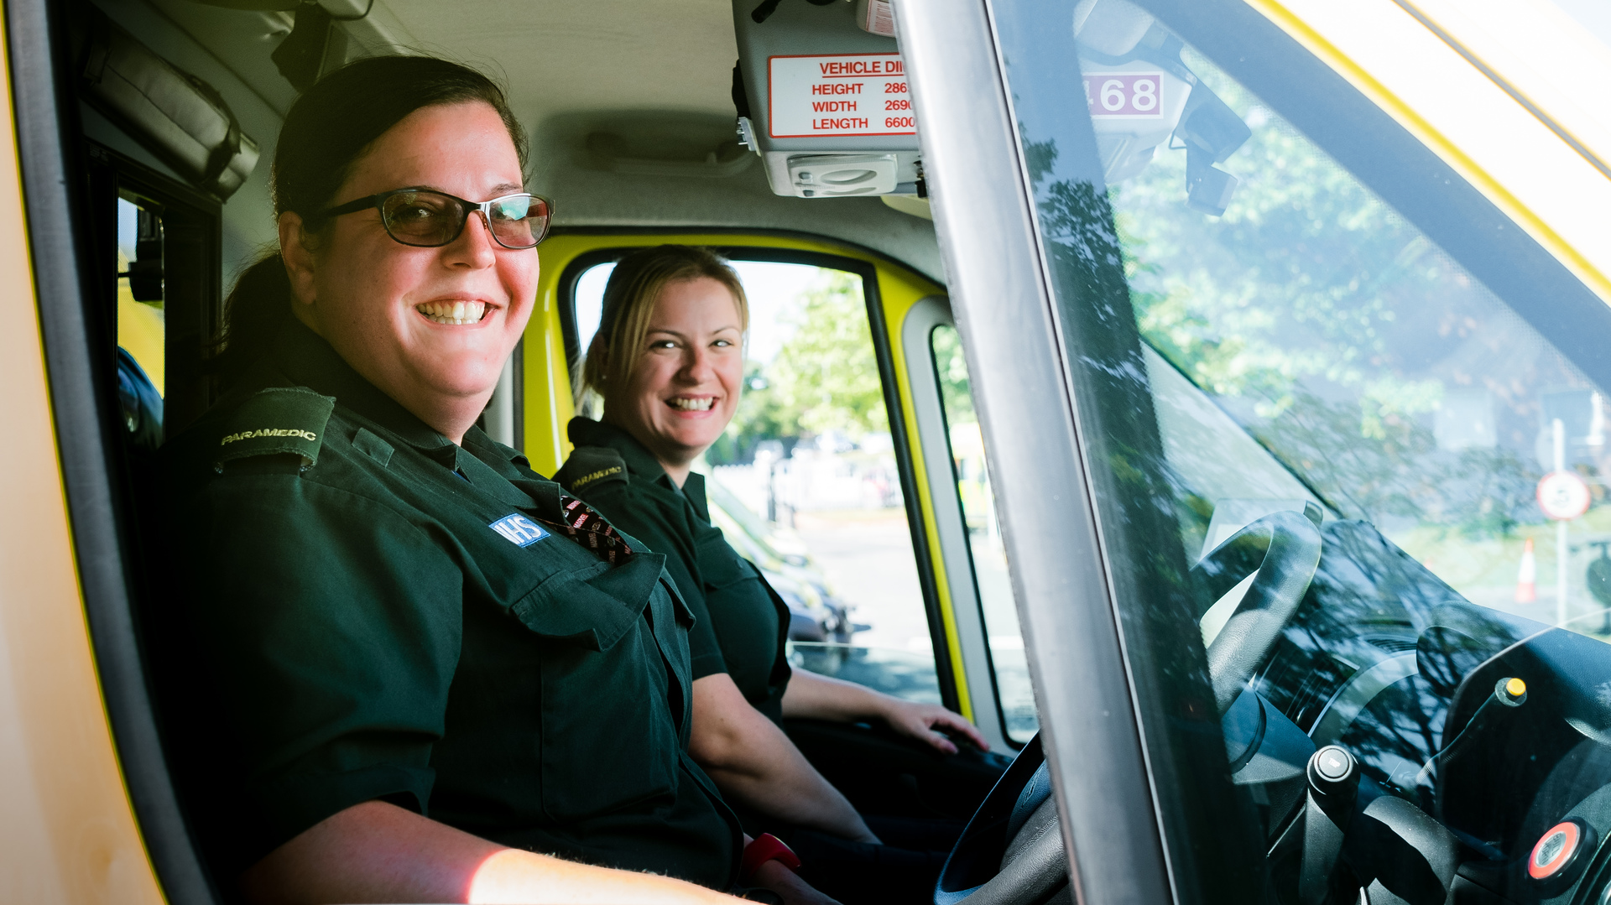

W is UKTV’s premium entertainment channel, offering audiences a dazzling mix of original factual entertainment formats - John Bishop in conversation with…, Dr Christian Will See You Now and Inside The Ambulance - alongside hit shows from the US including Code Black and MasterChef USA, plus carefully curated gems from C4 and the BBC.
Appealing to intelligent and discerning audiences, with a female skew 30-39, W showcases people operating outside of their comfort zone.
W averaged a 0.87% share in Pay in Q3 2018, maintaining its rank as the 4th largest Pay Only Entertainment channel across Pay platforms
W reached 8.4m adults a month in Q3 2018, the 3rd highest for a Pay Only Entertainment channel and ahead of Comedy Central
Session length averaged 22.7 mins in Q3, up +6% YoY.
Profile source: BARB/Advantedge, Q3 2018 Base Ads 16+
Notes:
16-34s, Q1 24%, Q2 26%

Slide 44
W reached 8.4m adults a month in Q3 2018, the 3rd highest for a Pay Only Entertainment channel and ahead of Comedy Central.
John Bishop: In Conversation With… returned for S4 in July, with the series averaging 125k (+127% vs slot) in addition to a stellar 71% ABC1 profile. His conversation with Paddy McGuinness drew a series high of 196k (+257%)
The West Midlands Ambulance Service hit the road once again as Inside the Ambulance returned for S4; the series averaged 229k (+110% vs slot) across weeknights 8pm
Long-standing favourite Masterchef Australia returned for S10, averaging 191k (+98% vs slot) in Q3 alongside a 23% 16-34 profile
Code Black S3 drew a season high of 305k as it reached its conclusion in Q3, the series overall averaging 265k, up +9% on S2.
Top Programmes
Quarter-on-Quarter performance (16+ share)
# | Programme Title | '000 (avg) | '000 (max) | Count
1 | Code black | 83 | 305 | 33
2 | Inside the ambulance | 92 | 292 | 67
3 | Masterchef australia | 119 | 244 | 47
4 | John bishop: in conversation with | 66 | 196 | 30
5 | Masterchef junior usa | 48 | 184 | 45
6 | Tipping point | 33 | 141 | 416
7 | 999 rescue squad | 40 | 135 | 13
8 | One born every minute | 55 | 121 | 43
9 | Helicopter er | 41 | 120 | 30
10 | Five star babies | 95 | 120 | 2
 | 2017 | 2018 | YoY
Q1 | 0.41 | 0.4 | -2%
Q2 | 0.4 | 0.45 | 13%
Q3 | 0.45 | 0.42 | -7%
Q4 | 0.39
YTD | 0.42 | 0.42 | 0%
2018 Q3 Top programmes, ranked by max 000s (16+)
Source: BARB/Advantedge, Jan 2017 - Sep 2018 Base Ads 16+
Source: BARB/Advantedge, Q3 2018, Base Ads 16+

Slide 45
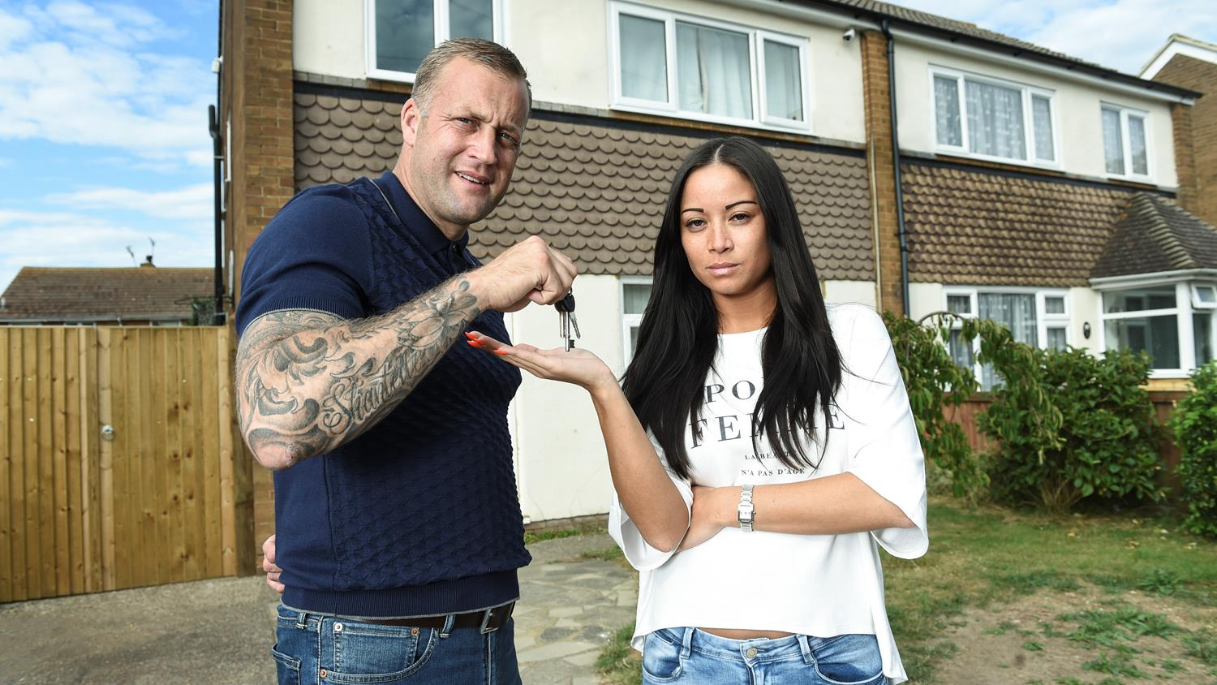
Watch viewers…
Are TV addicts (Index: 171), watching TV is their favourite pastime (Index: 156), they pay most attention to adverts on the TV (Index: 138) and find them most useful in helping with purchase decisions (Index: 145).
They enjoy the adverts as much as the programmes (Index: 144), find TV advertising interesting and gives them something to talk about (Index: 131) and enjoy watching ads featuring their favourite celebrities (Index: 132).
Whilst watching TV, they often notice products or brands that appear in TV programmes and films (Index: 135), and search on the internet for what they see advertised (Index: 136).
They love to buy new gadgets and appliances (Index: 113), and when they see a new brand they often buy it to see what it’s like (Index: 128).
Source: GB TGI 2018: 07/17-06/18, watched W within the last week.

Slide 46
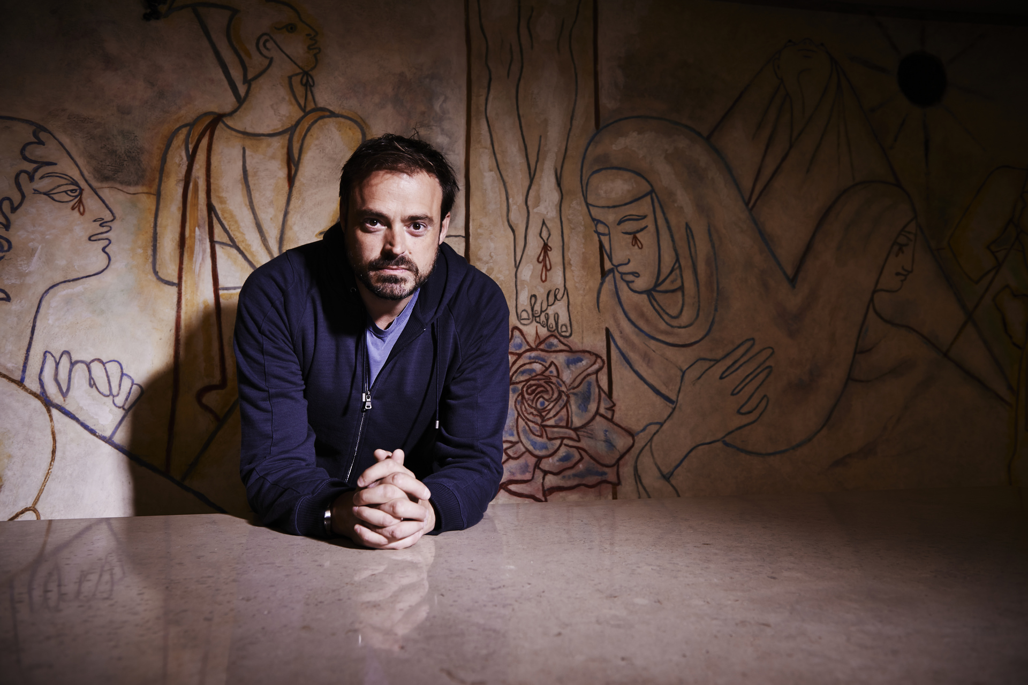

Yesterday is a channel that provides quality entertainment from fascinating documentaries through to classic shows from the past. Exploring more about the wider world it looks at the how and why, offering a wide range of high-quality factual programmes like Impossible Engineering, Nazi-Victory: The Post-War Plan and Forbidden History. Yesterday also looks back at classic comedies and music through history.
Yesterday remains the biggest factual channel in the UK, bringing in 12m adults per month across Q3
The channel delivered it’s best Q3 since 2012, seeing share up +10% YoY averaging 0.73%
In Q3, the channel was the 5th highest rating non-PSB channel on Freeview with a 1.17% share.
Profile source: BARB/Advantedge, Q3 2018 Base Ads 16+

Slide 47
Yesterday delivered it’s best Q3 since 2012, seeing share up +10% YoY averaging 0.73%
Forbidden History S5 launched in Q3 averaging 242k, +55% vs slot. The series peaked with 302k, (+93% vs slot)
Also launching in Q3, Viking Dead saw success peaking on its premiere episode with 270k, +41% vs slot
Comedy continues to perform strongly in peak with ‘allo ‘allo peaking at 271k, up +82% vs slot.
Top Programmes
Quarter-on-Quarter performance (16+ share)
2018 Q3 Top programmes, ranked by max 000s (16+)
Source: BARB/Advantedge, Jan 2017 - Sep 2018 Base Ads 16+
Source: BARB/Advantedge, Q3 2018, Base Ads 16+.

Slide 48

Yesterday viewers…
They rely on TV to keep informed (Index: 125), say TV adverts are the ones they find most useful in helping make purchase decisions (Index: 125) and that they are the adverts they pay most attention to (Index 122).
They believe it’s worth paying extra for good quality goods (Index: 105), and are prepared to pay more for good quality beer or wine (Index: 107).
They think that it’s important to be well informed about things (Index: 104) and claim that how they spend their time is more important than the money they make (Index: 106).
Source: GB TGI 2018: 07/17-06/18, watched Yesterday within the last week.

Slide 49


UKTV Play is the on demand TV service offering free access to 1000s of hours of comedy, drama, real crime, documentaries and paranormal TV from Dave, Drama, Really and Yesterday. There’s so much brilliant TV on UKTV Play – Taskmaster, Red Dwarf, Yianni: Supercar Customiser, Most Haunted, Impossible Railways, Abandoned Engineering, The Heart Guy, The Bill and Birds of a Feather – to name a few, so you’ll never be stuck for something to watch. You can view full episodes of lots of our shows before they air on TV, access themed collections, or binge on full box sets. With the UKTV Play app you can stream your favourite TV for free via your computer, tablet, phone or via your TV. It has never been easier to watch the TV you love.
Despite completing mandatory registration across all platforms, UKTV Play enjoyed a +50% increase in views YoY in Q3 2018, remaining UKTV’s fastest growing brand
Dave (+74%) and Drama (+72%) saw the largest YoY increases in Q3.
Source: Adobe Analytics Q3 2018

Slide 50
UKTV Play had another great quarter in Q3, up +50% YoY.
Series 7 of UKTV Original Taskmaster launched in Q3, propelling the show to contribute to an impressive 22% of all viewing on UKTV Play
New UKTV Original Judge Romesh also launched in Q3 and featured in the player’s top 10 programmes, with 289k views
Q3 saw the launch of Classic Eastenders, bringing in an additional 397k views and making it the 3rd top performing programme
Following the Series 1 and 2 box-set drops in Q2, The Heart Guy continued to perform well in Q3; now the 8th performing title on UKTV Play.
Top Programmes
Quarter by Quarter Performance
Rk | Programme | Views
1 | Taskmaster | 2,067,016
2 | The Bill | 438,582
3 | Classic Eastenders | 396,558
4 | Ghost Adventures | 291,803
5 | Judge Romesh | 287,728
6 | Soldier Soldier | 225,451
7 | London's Burning | 201,443
8 | The Heart Guy | 188,480
9 | Help! My House Is Haunted | 183,313
10 | Birds of a Feather | 180,026
 | 2017 | 2018 | YoY
Q1 | 5,021,999 | 8,806,844 | 75%
Q2 | 6,662,192 | 8,551,672 | 28%
Q3 | 6,629,655 | 9,930,947 | 50%
Q4 | 9,233,744
YTD | 18,313,846 | 27,289,463 | 49%
Source: Adobe Analytics Q3 2018

