Slide 1
Channel 4
Quarterly Update
Q1 2019

Slide 2
Channel 4 Highlights
Channel 4 reached 90% of Adults, 90% of ABC1 Adults and 81% of 16-34s in Q1 2019.
Channel 4 reached 41 million Adults, 22 million ABC1 adults and 9.3 million 16-34s on average each month
30% of people who state that Channel 4 is their favourite channel are 16-34
Channel 4 viewers are +24% more likely to say TV adverts are the types of ads that they pay most attention to.
Channel 4 is the top converting commercial terrestrial channel for 16-34s and ABC1 Adults
Source: BARB/Techedge, Q1 2019 and GB TGI January – December 2018

Slide 3
Audience Insight

Slide 4
Channel 4 profiles a young ABC1 audience
16-34
35-44 45-54
55+
Men
Women
ABC1
C2DE
Source: BARB/Techedge, Q1 2019

Slide 5
Channel 4 reaches 79% of
ABC1 adults every month
Source: BARB/Advantedge, Q1 2019, reach condition = 3 consecutive mins. ITV includes breakfast and HD Base: ABC1 Adults

Slide 6
Channel 4 viewers are commercially receptive and proactive…
Index vs all adults – Any agree
Source: GB TGI January – December 2018 – C4 fan = C4 is favourite channel
100 = average adult

Slide 7
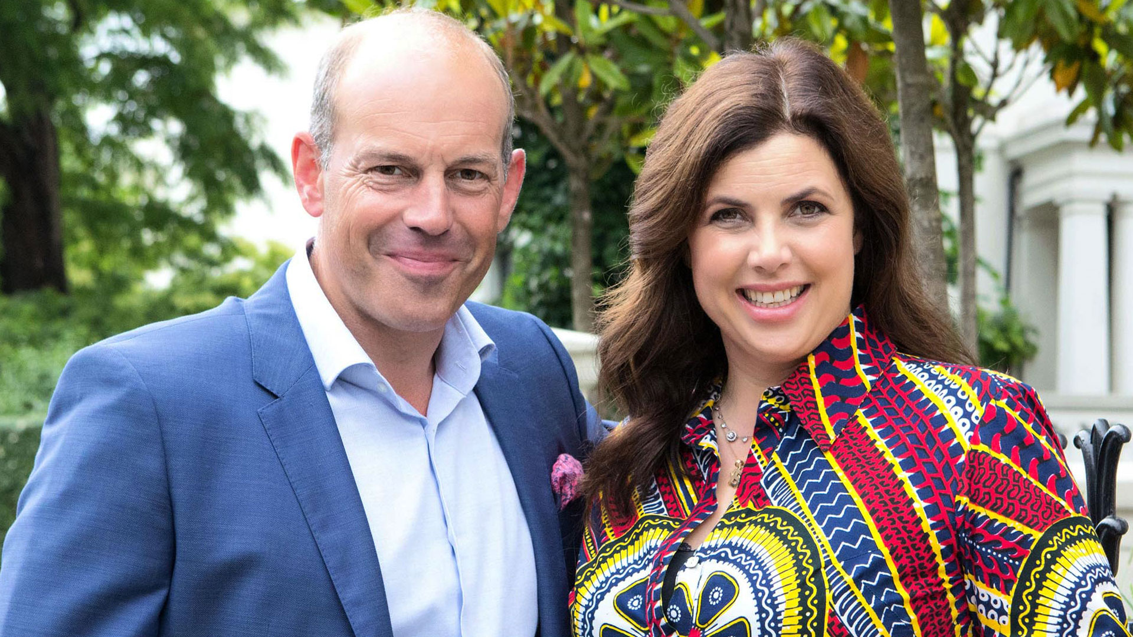
Reach of 100 TVRs
ABC1 Adults
% ABC1 Reach 1+
Source: BARB/K2, Based on 100 TVR target, 19wk1-19wk13; Channels include +1’s

Slide 8
Channel 4 has a clear brand image
Source : IPSOS Image Tracker, 2017 Q1

Slide 9
Channel 4’s audience is highly connected
Source: Channel 4/Kantar Digital Landscape Survey 2017; index 100 = average GB adult; in the last month ; C4 viewer = 1,2,3 favourite channel

